Slide 1

Pod Reveal Spring 2021
Notes:
Kael

Slide 2
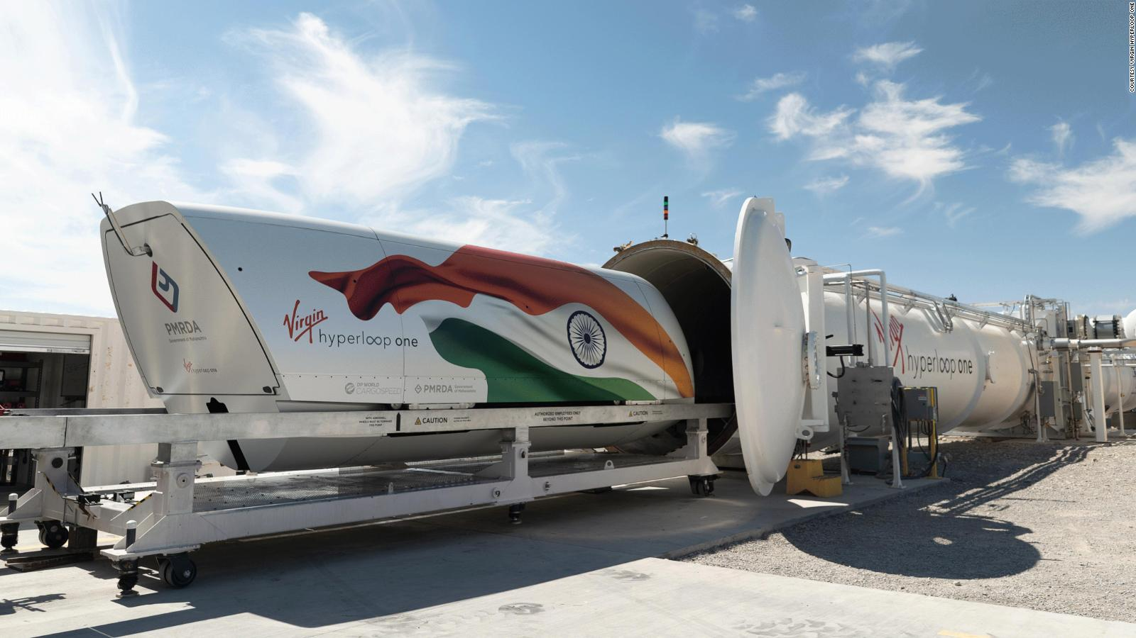
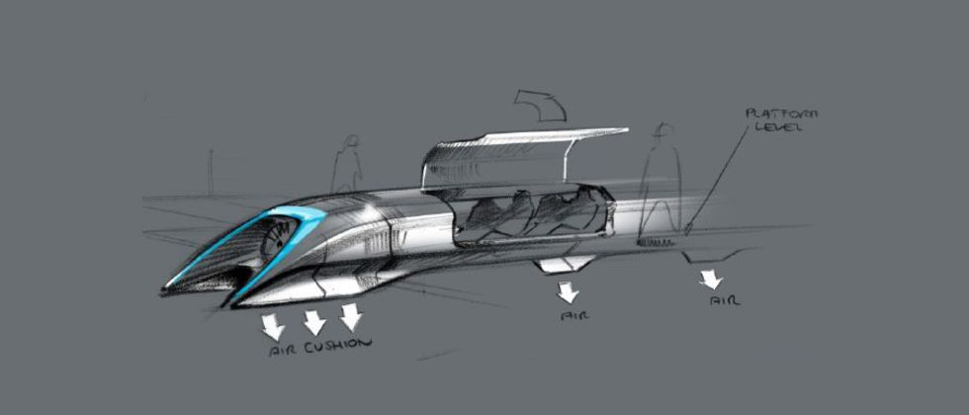
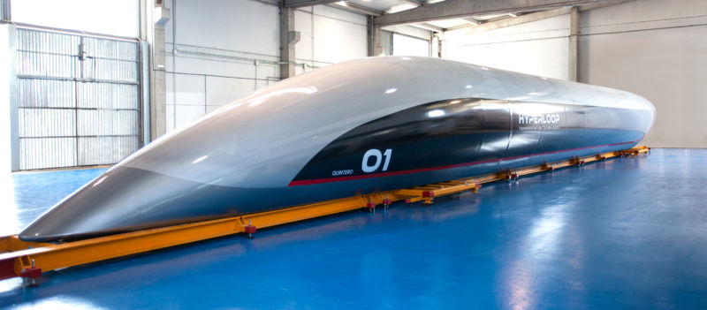
The Hyperloop Concept
Notes:
Kael

Slide 3
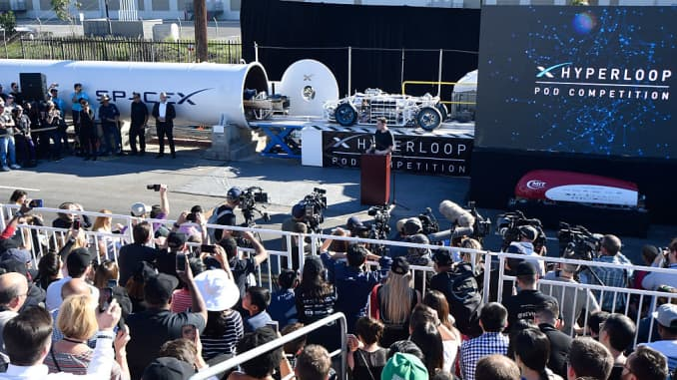
Hyperloop Pod Competition
Notes:
Vince

Slide 4

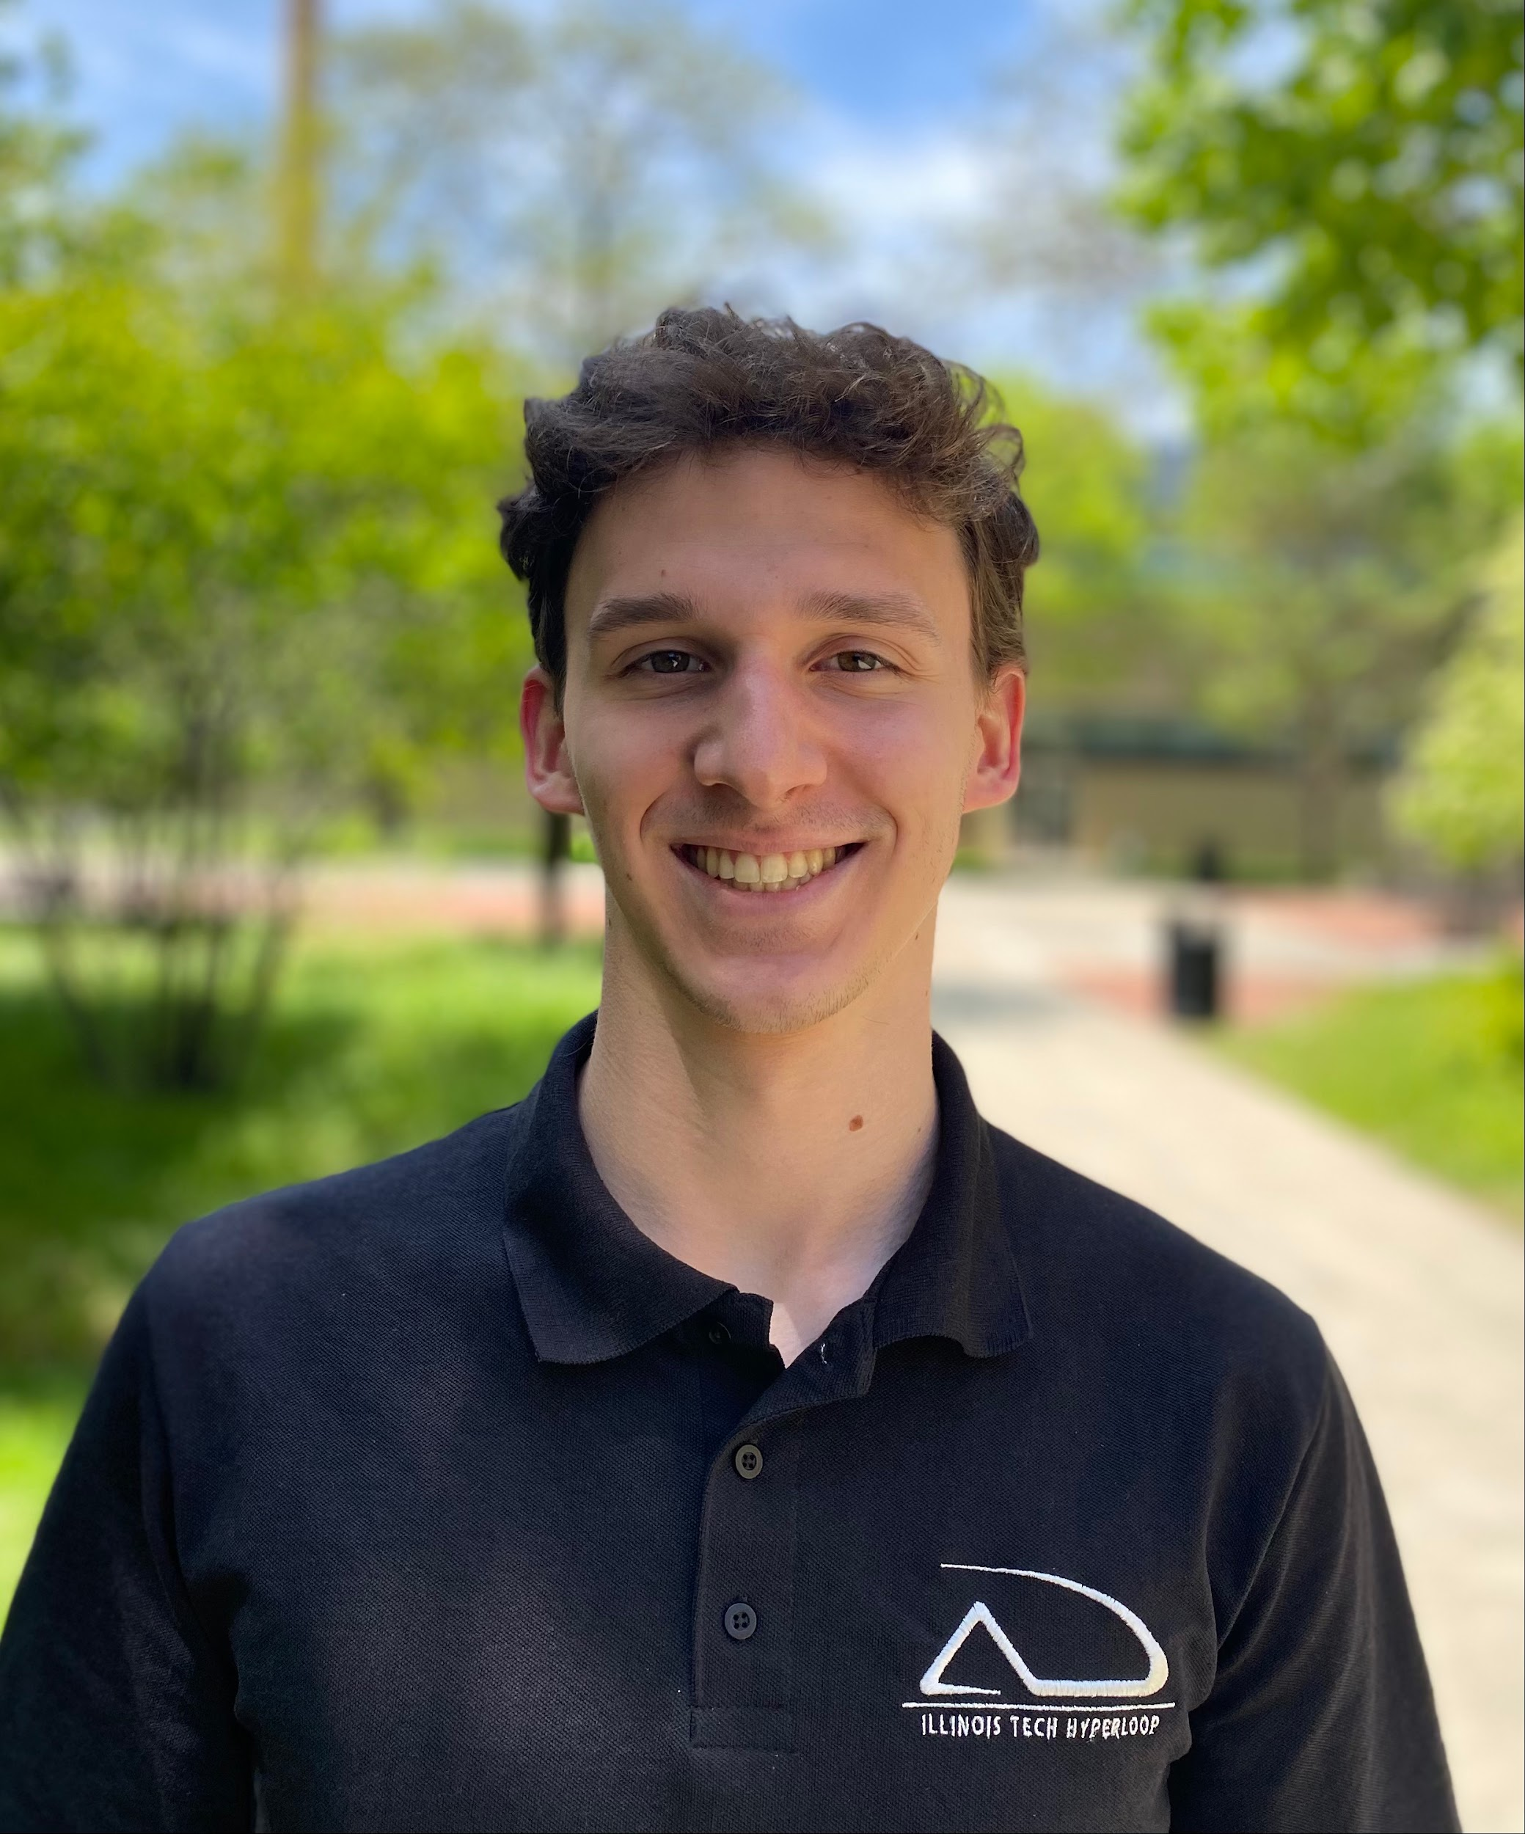
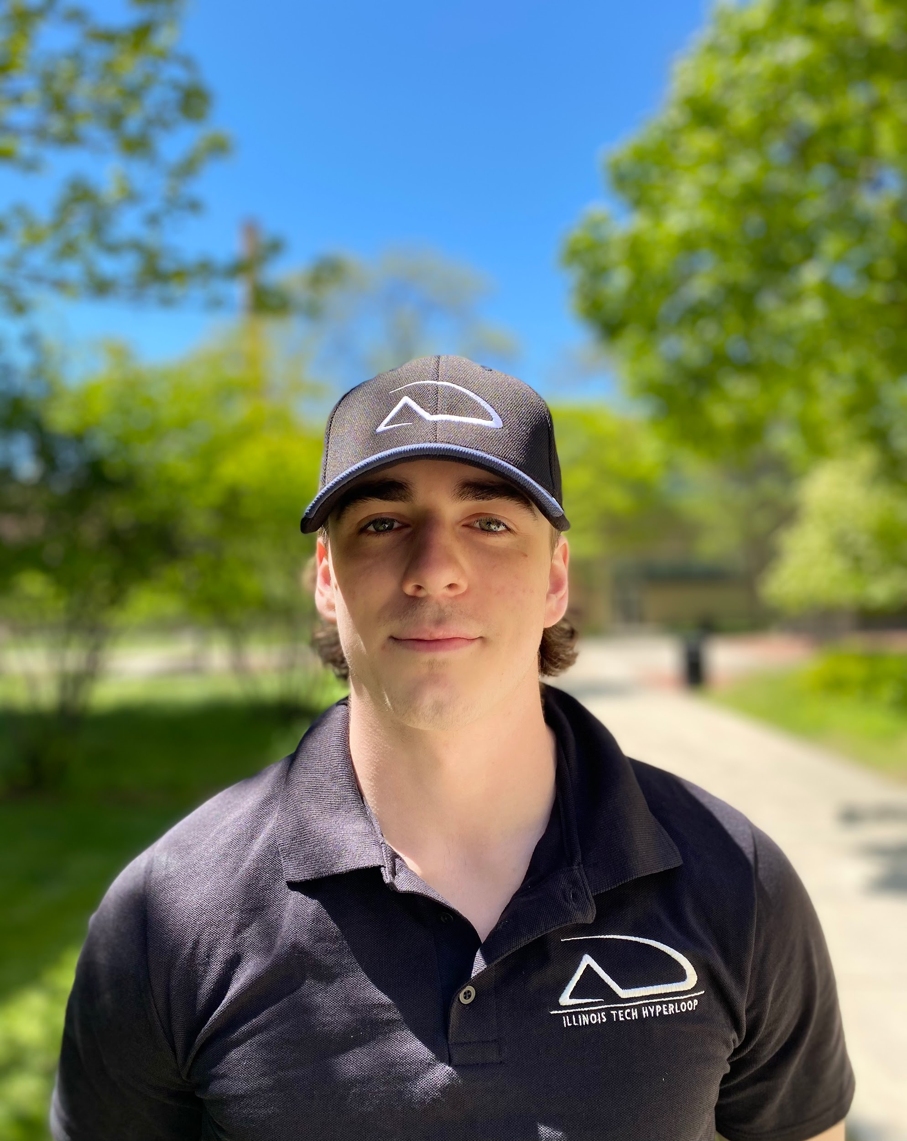
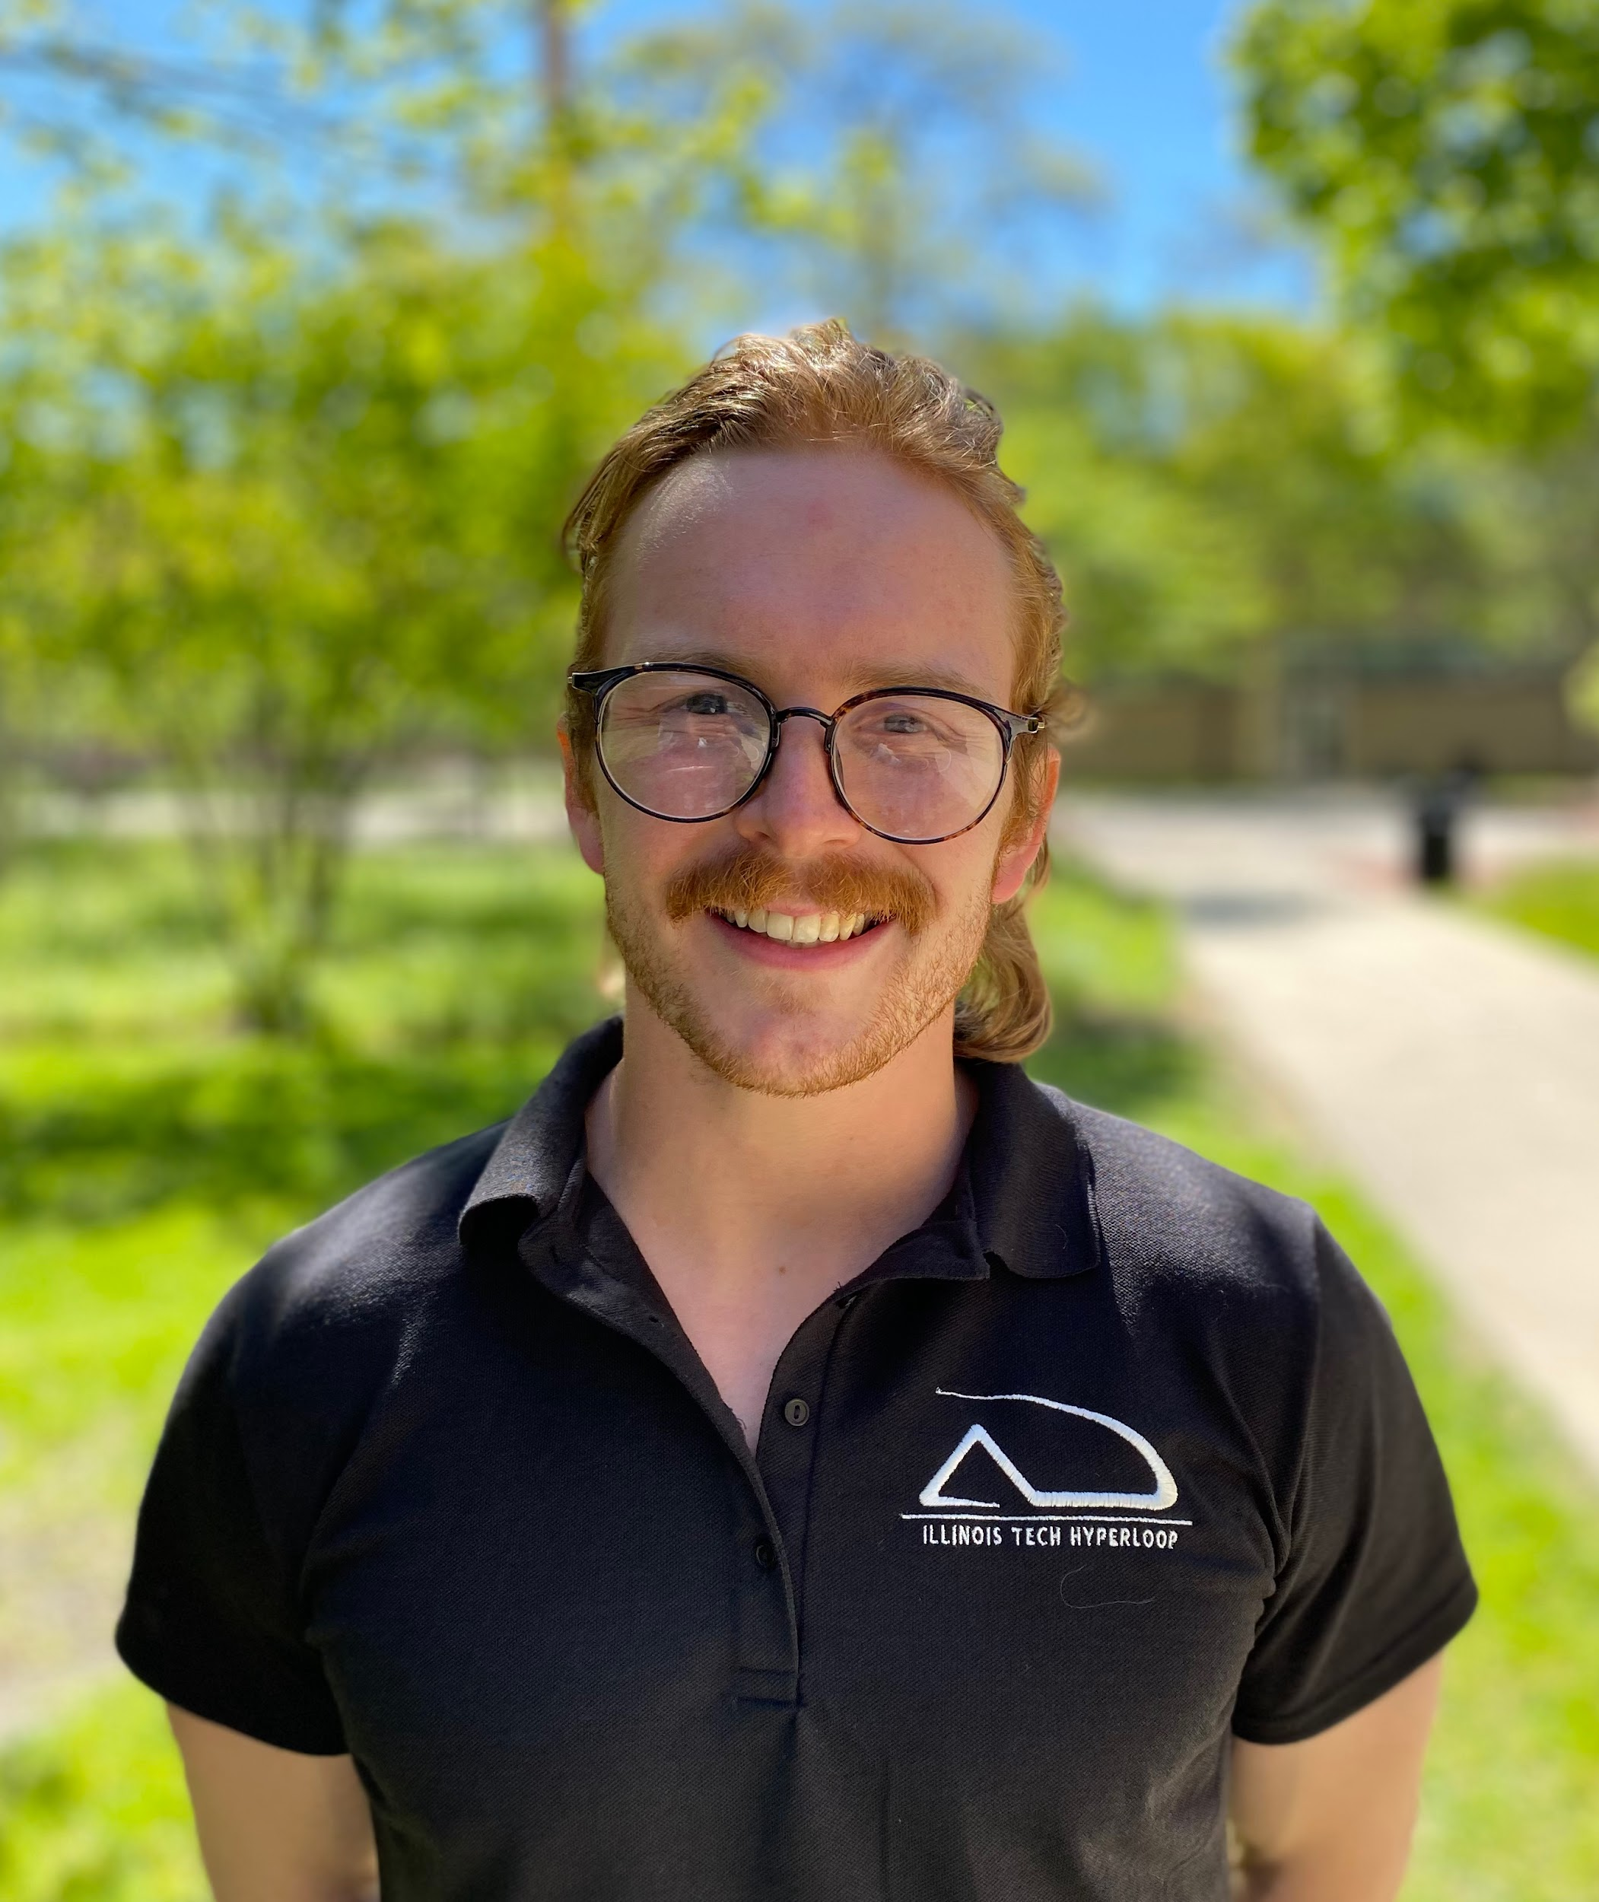
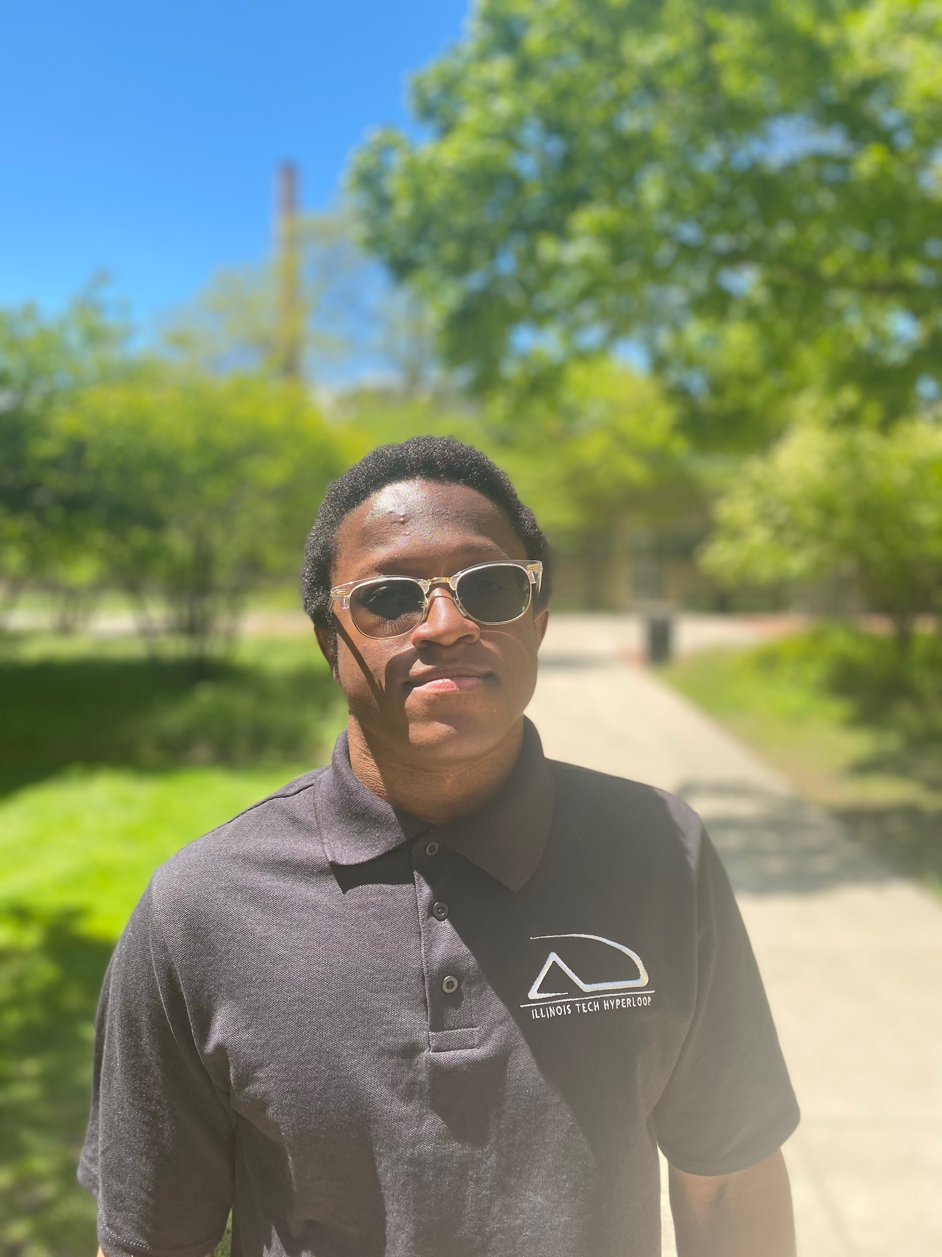

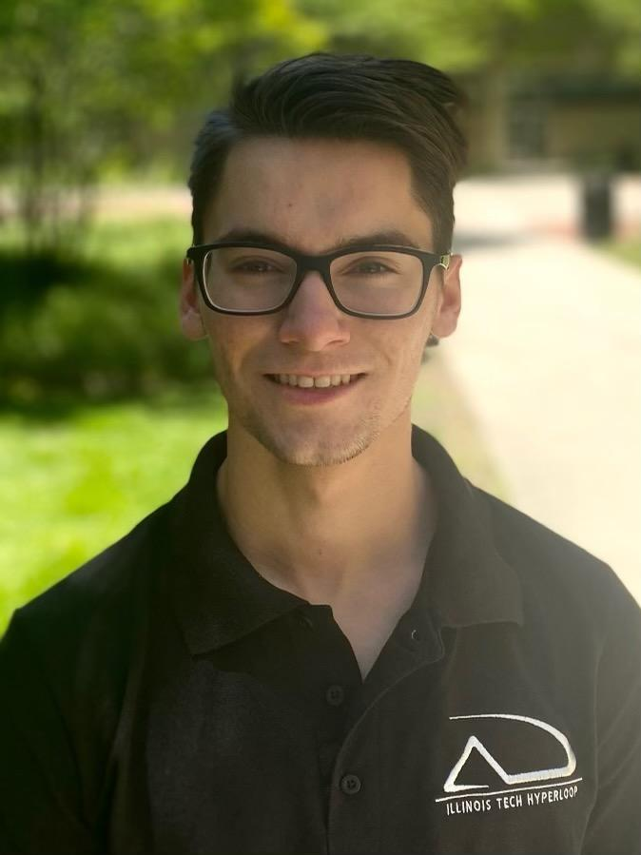
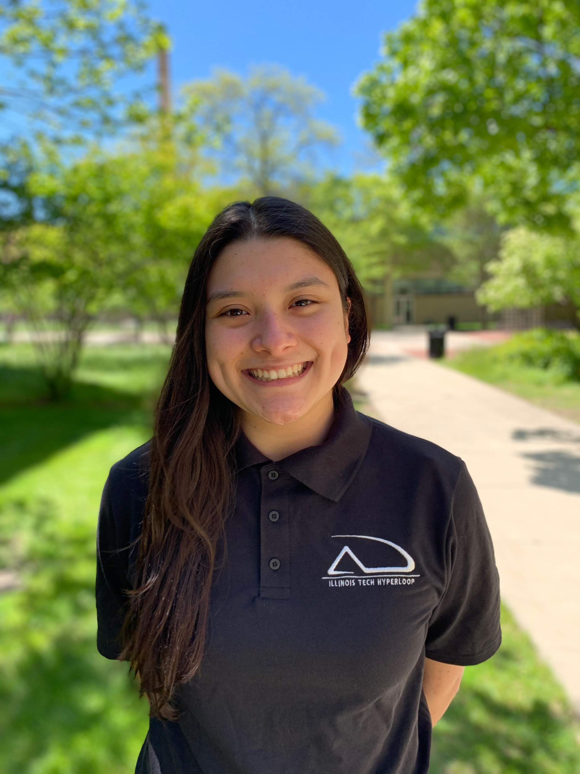

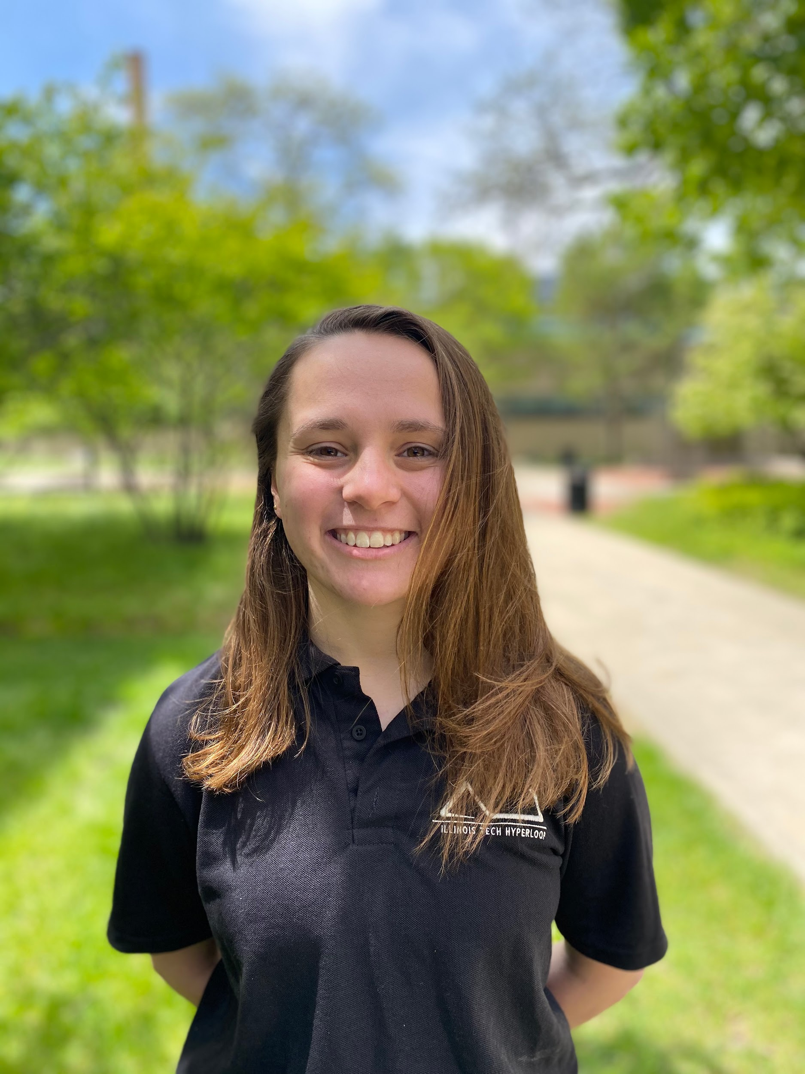
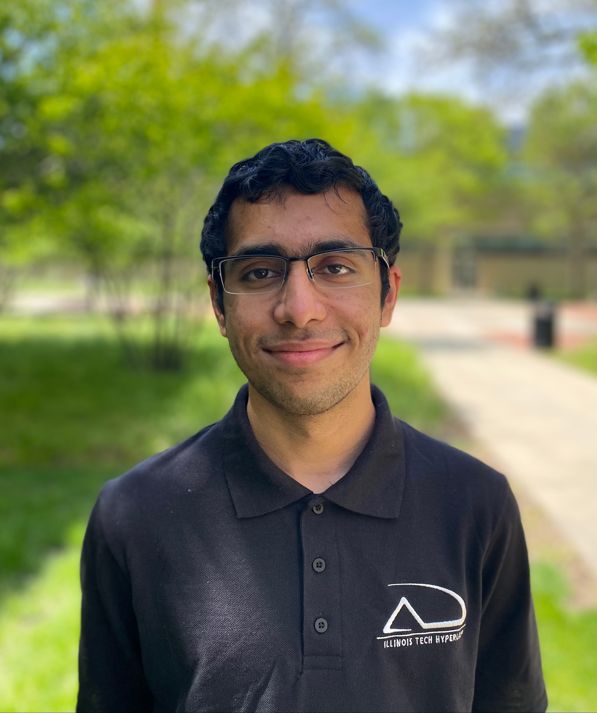
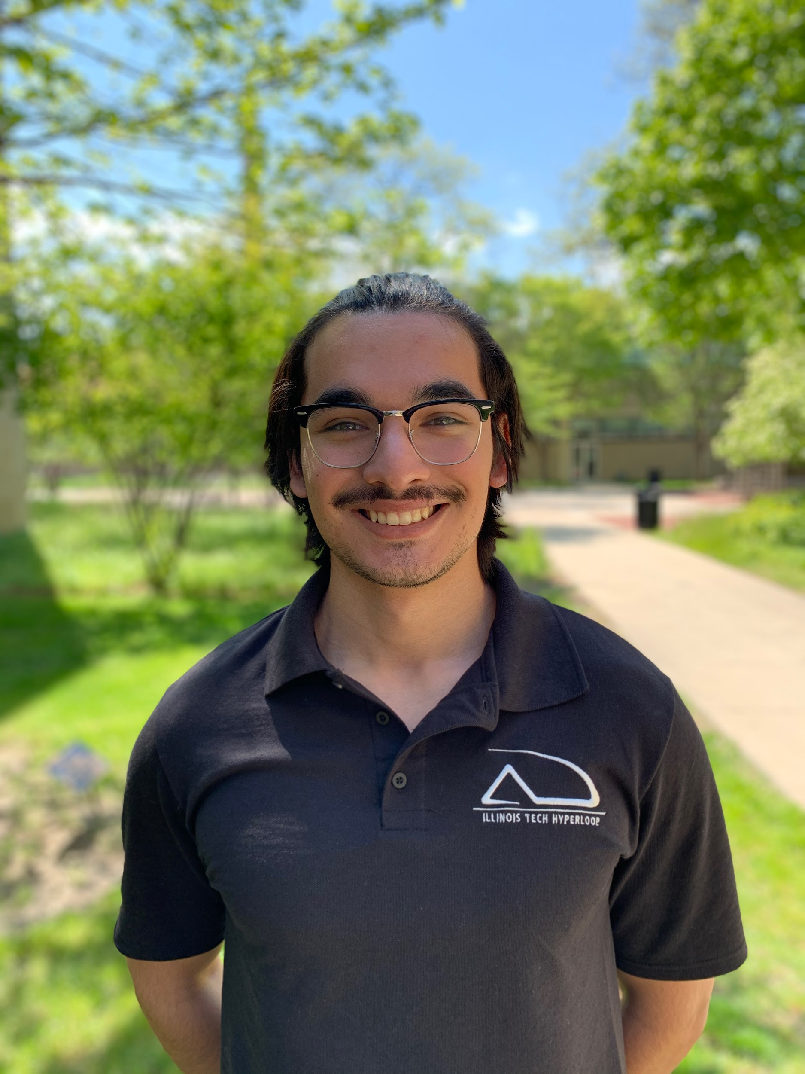
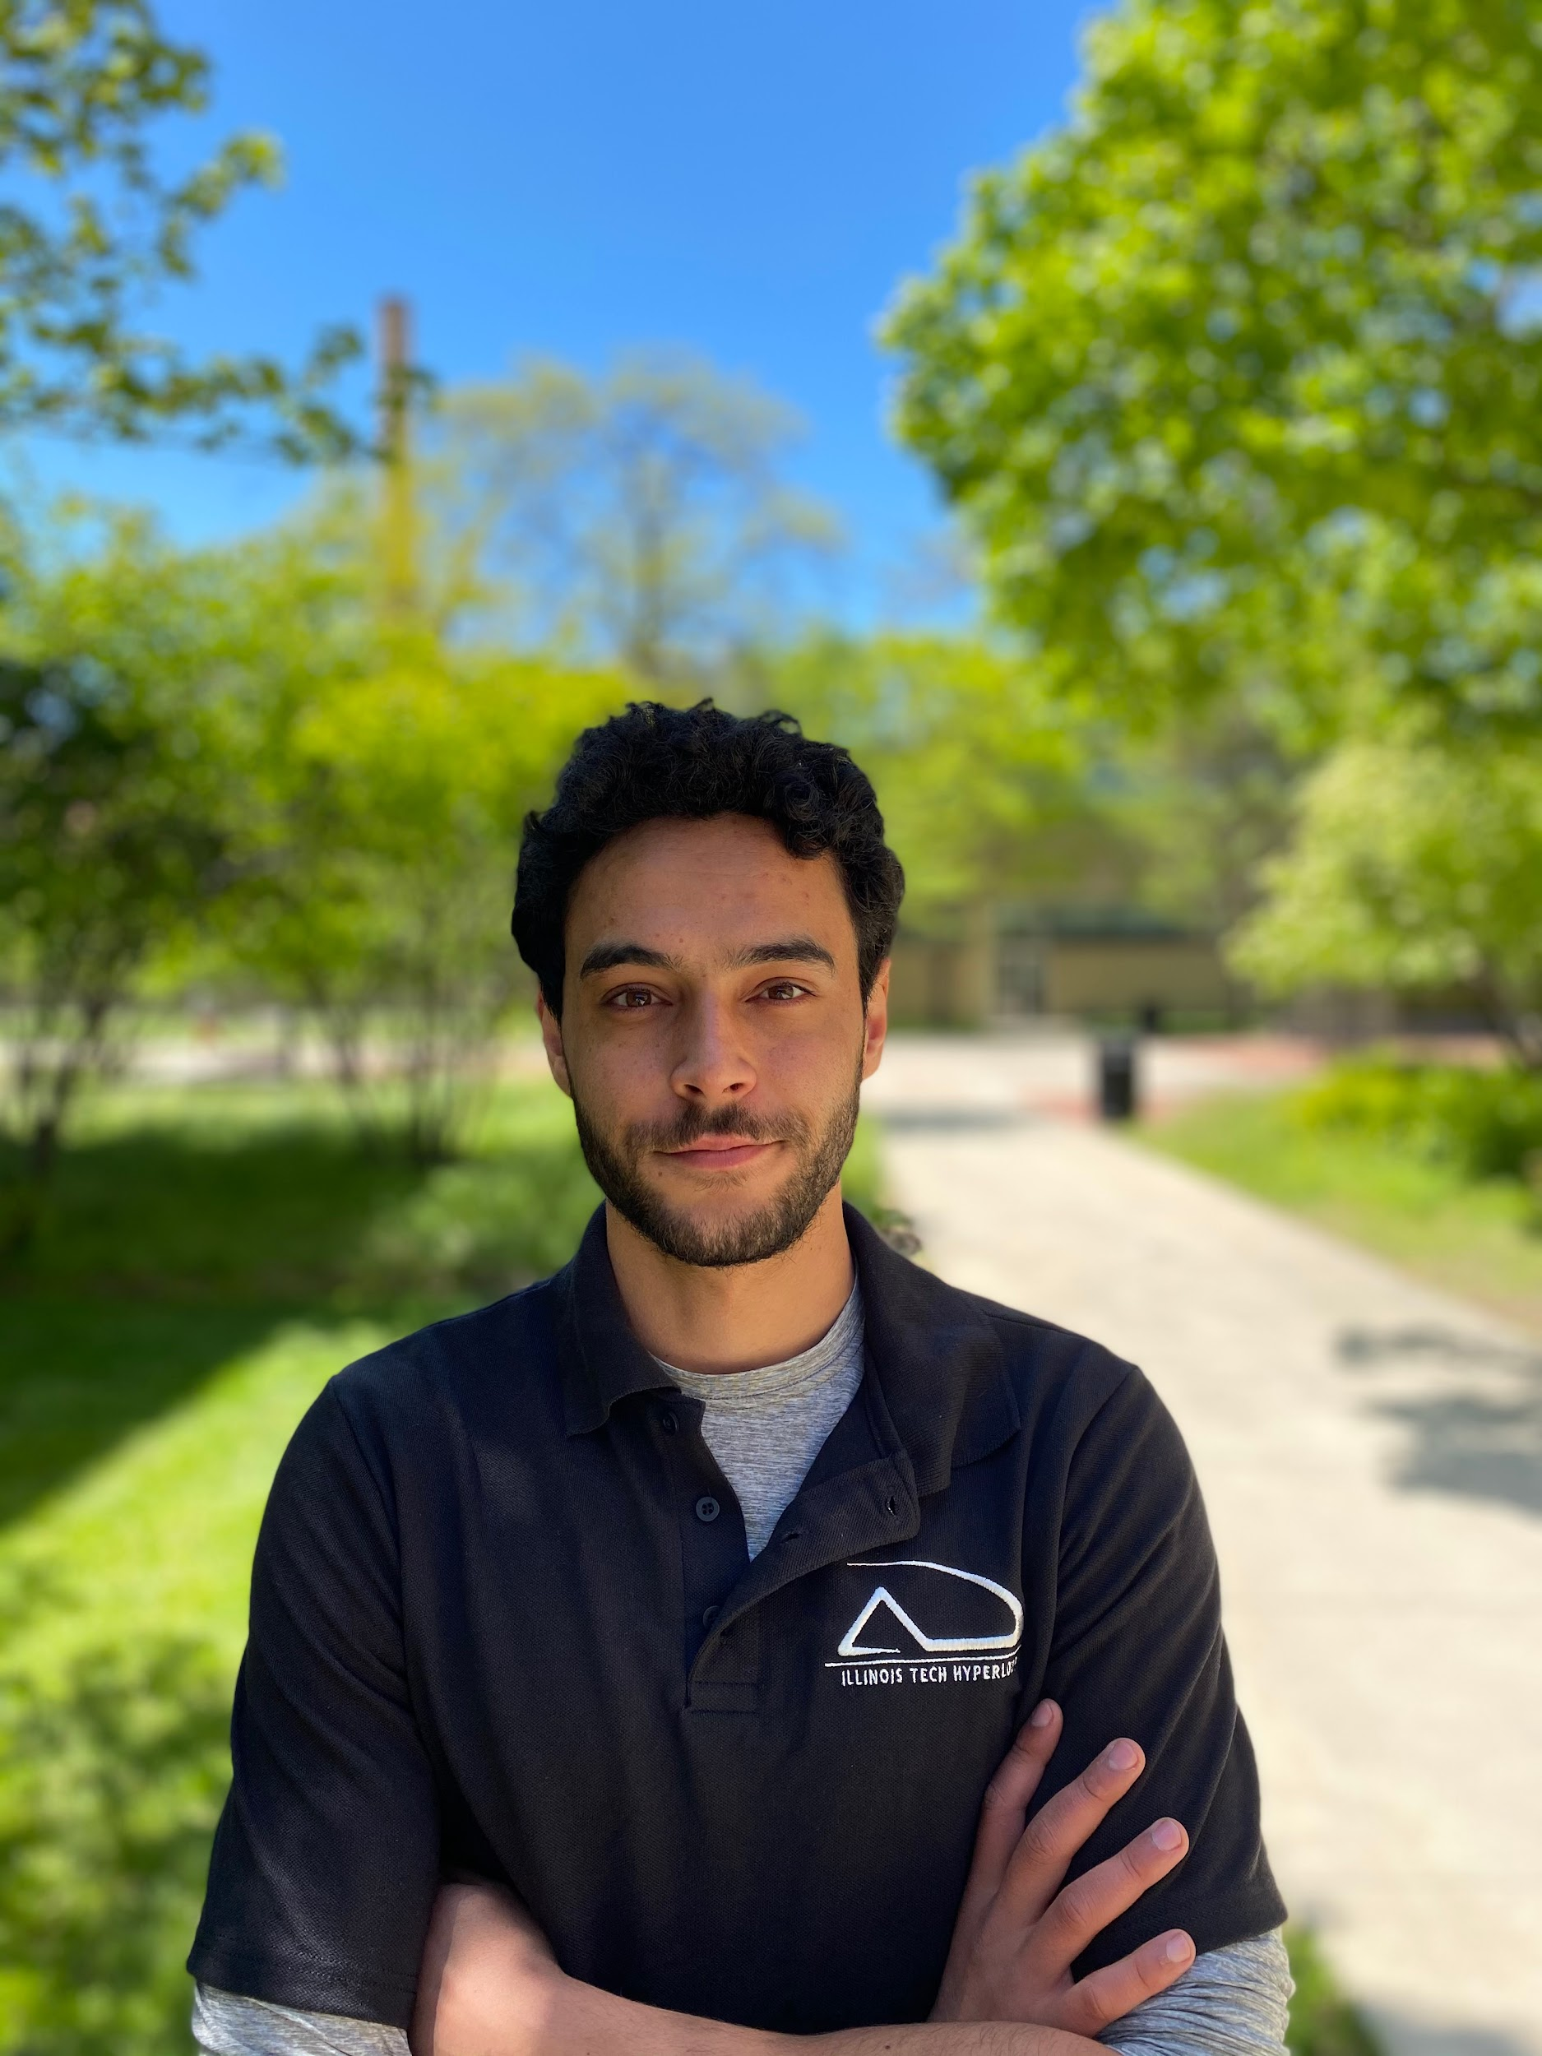
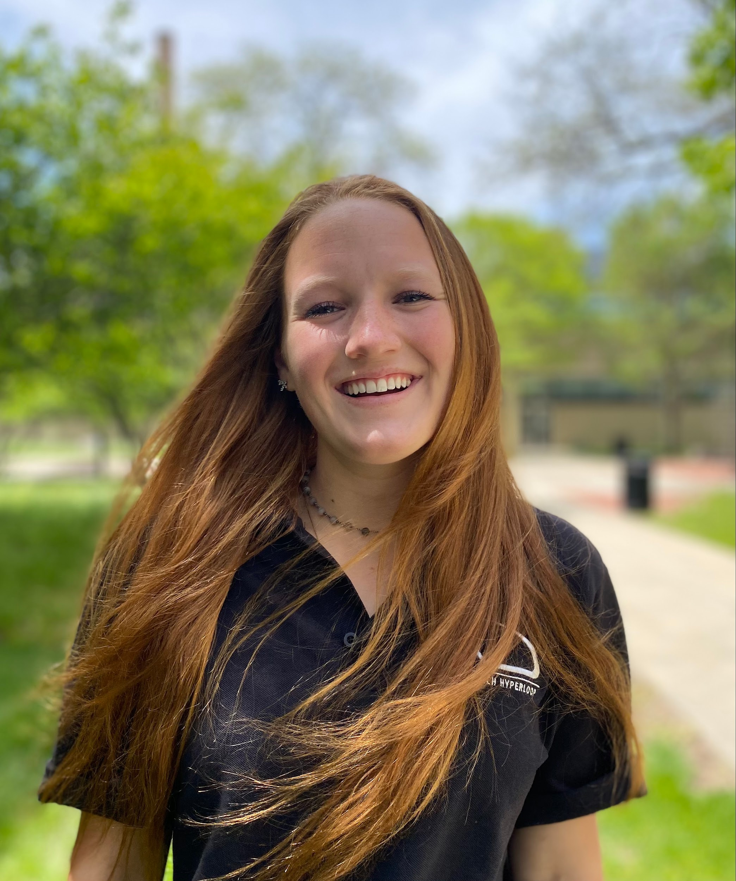

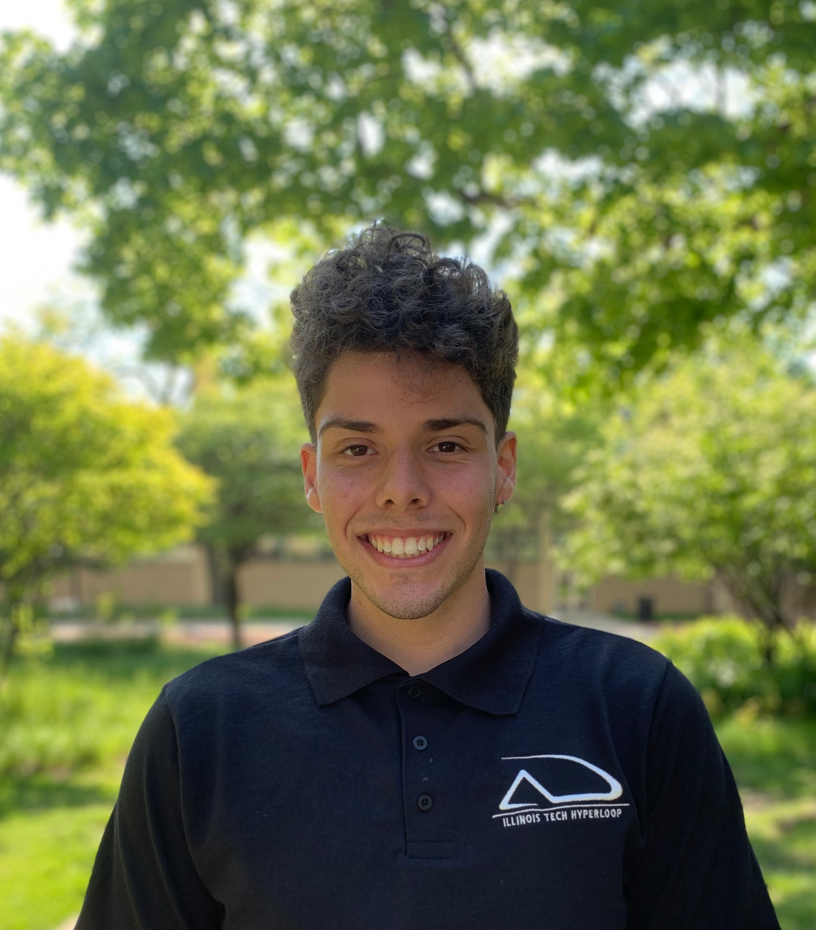
Illinois Tech Hyperloop
Notes:
Vince
Student org founded in 2016
Comp cancelled, engineering experience
First working prototype last year
6 members at the beginning of the semester
Better recruitment, leadership, and organization this year
Significant growth this year with 20+ active members

Slide 5
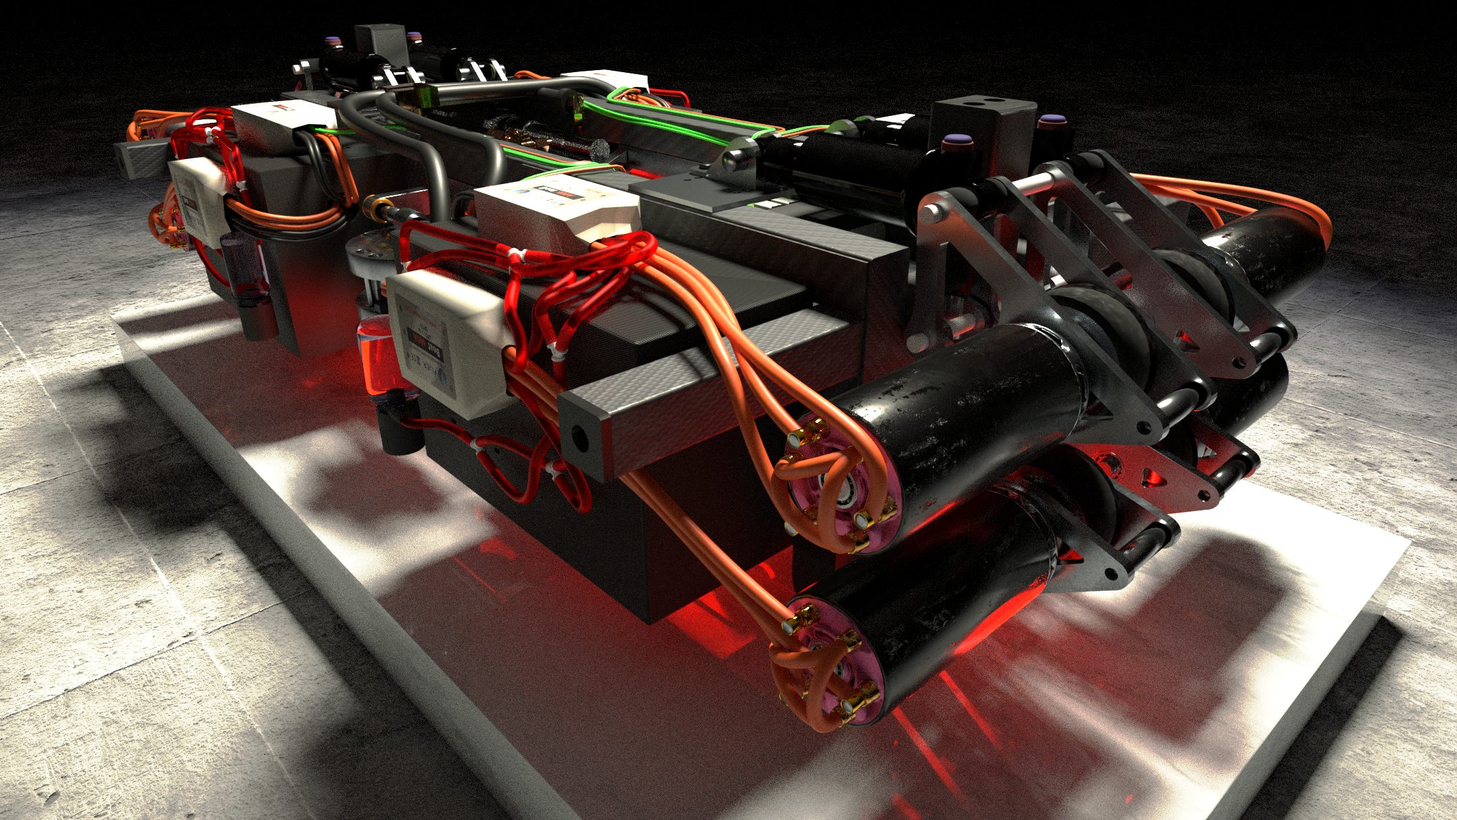
Design Overview
Notes:
Kael

Slide 6
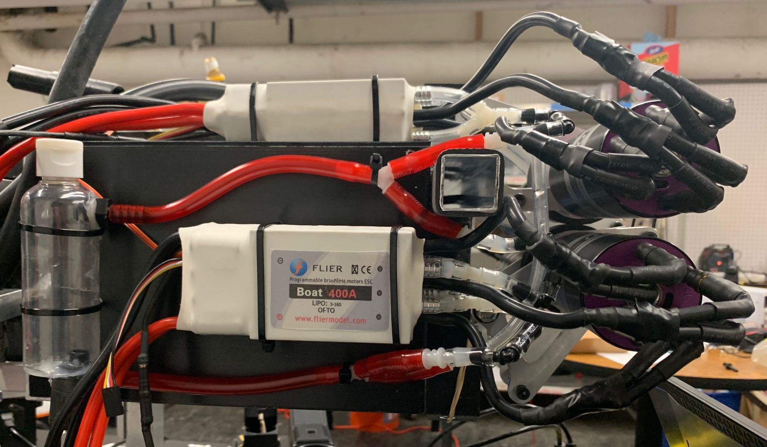
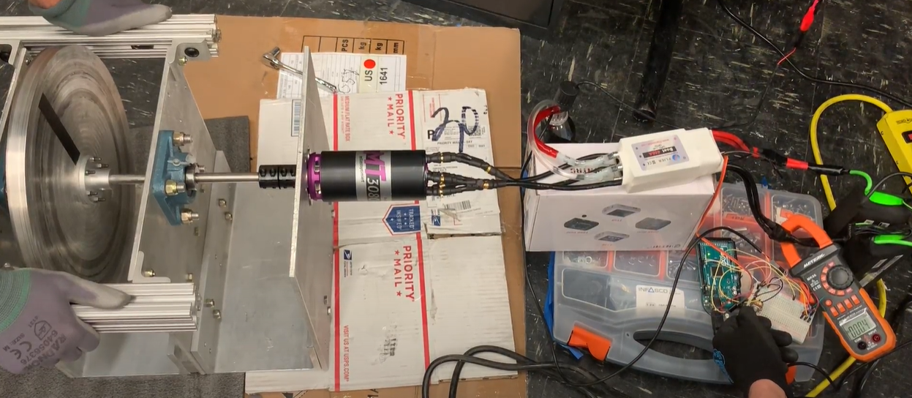
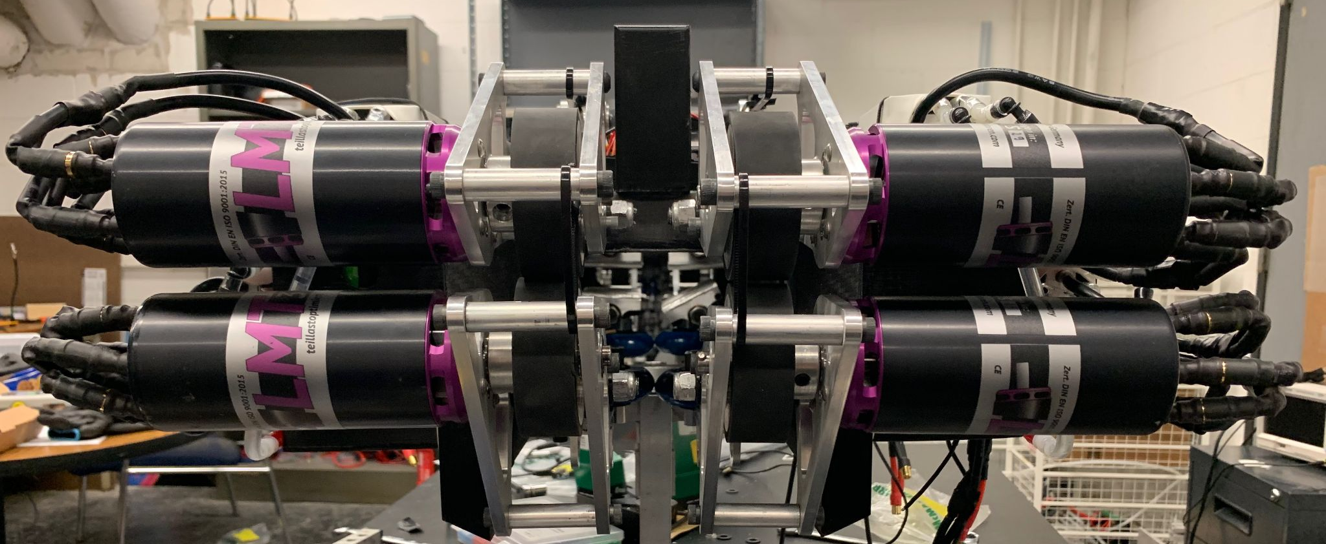
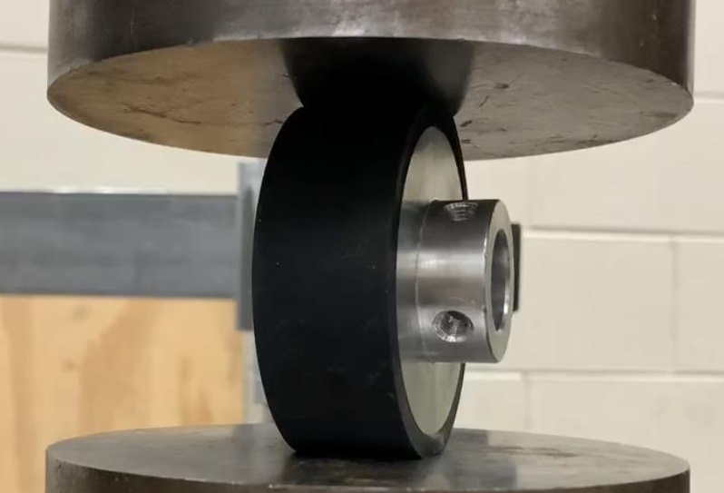
Propulsion
Notes:
0-60 in 1.5sec
Design constraints: track length, max acceleration
High power density motors high rpm with small wheels
Wheels for max acceleration, not top speed
Max power output: 142kW
Optimized acceleration for 100m test track

Slide 7
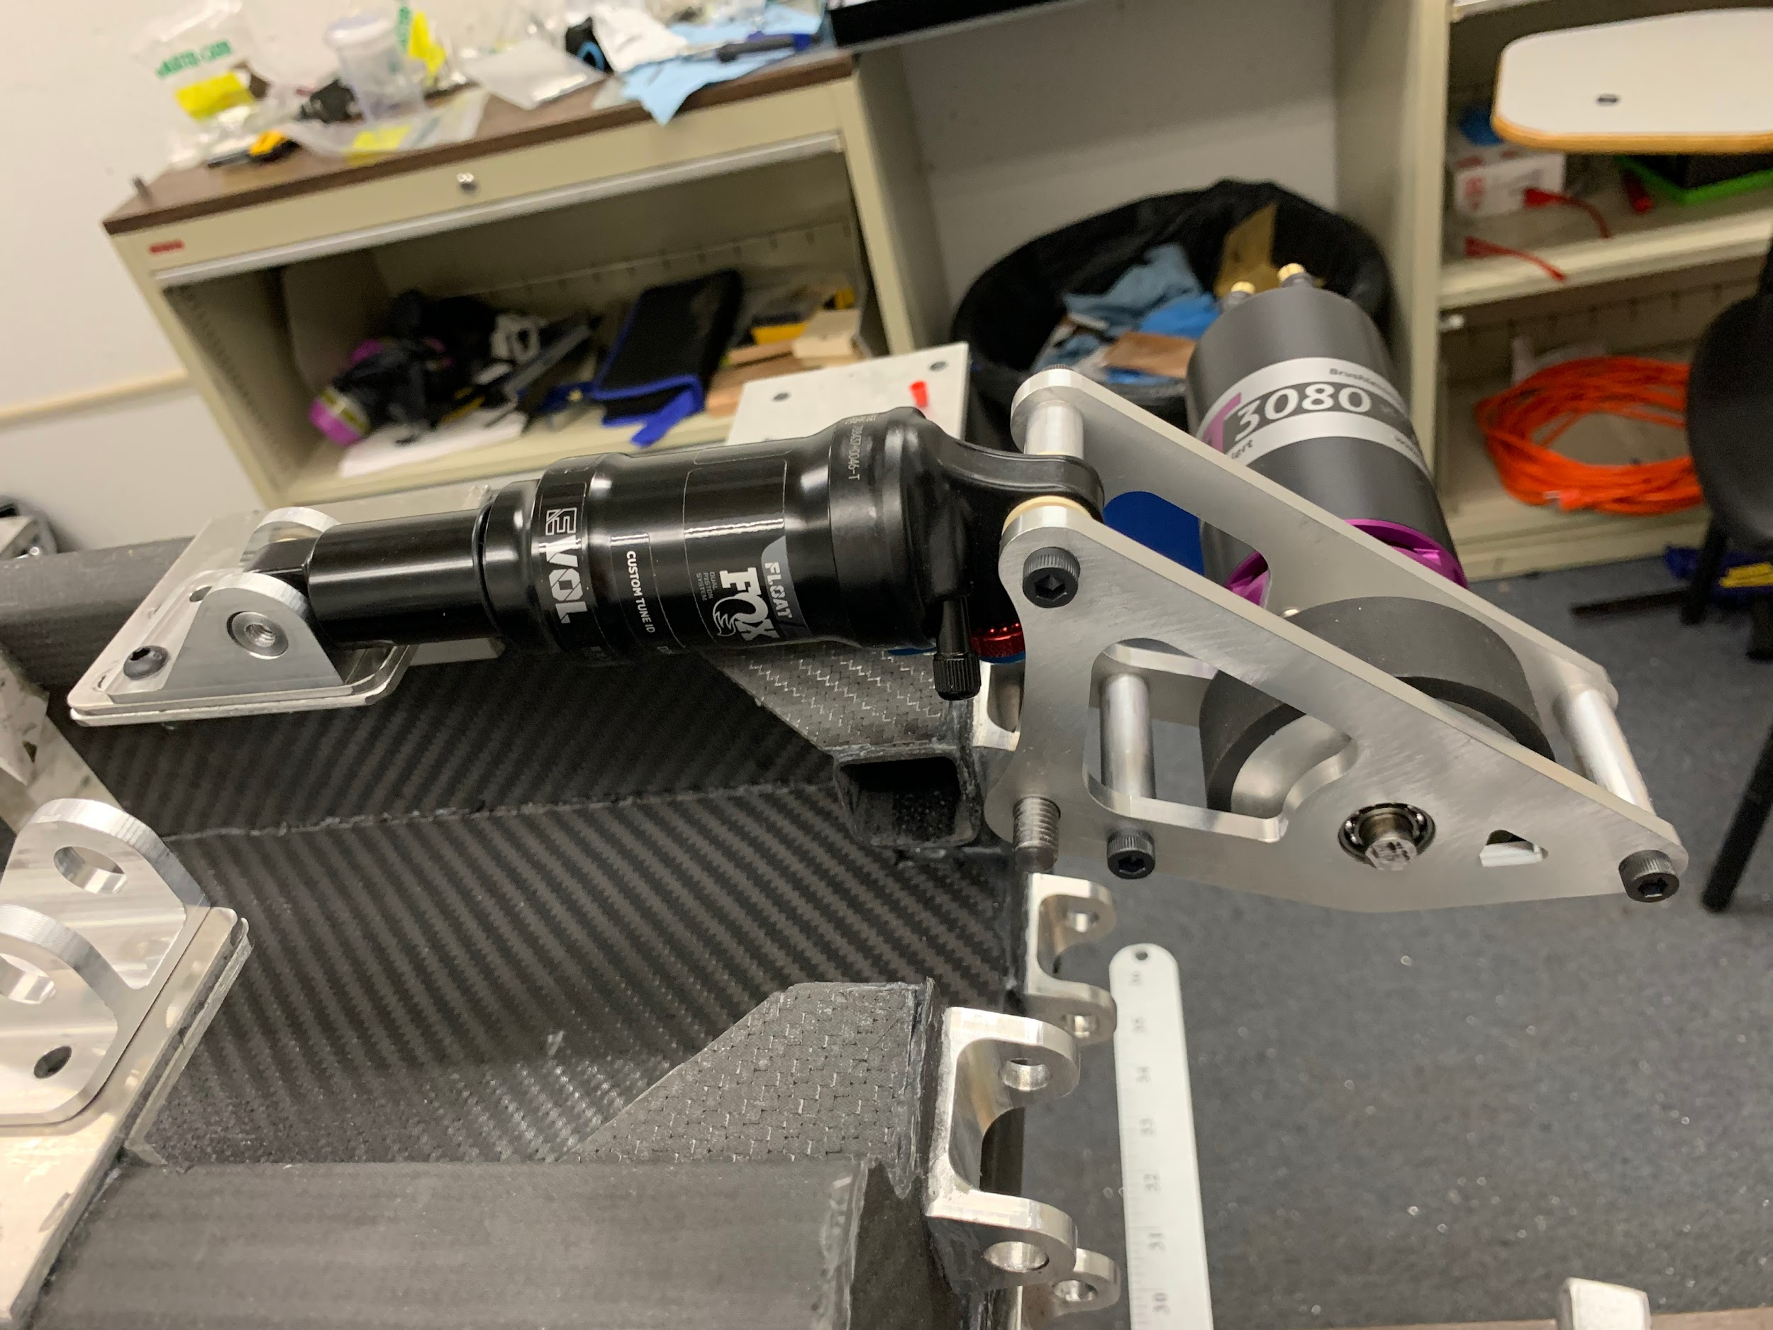
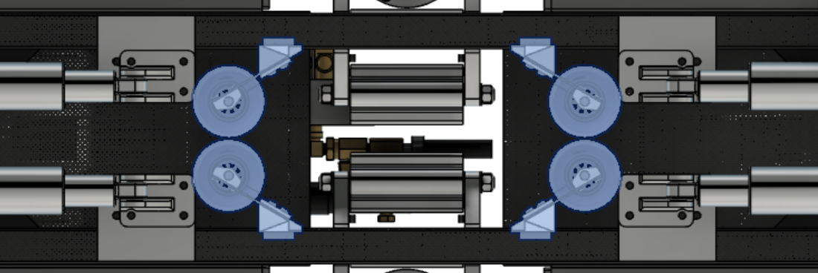
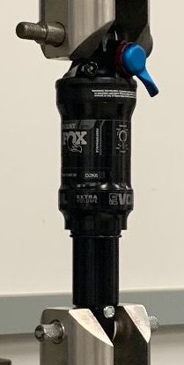
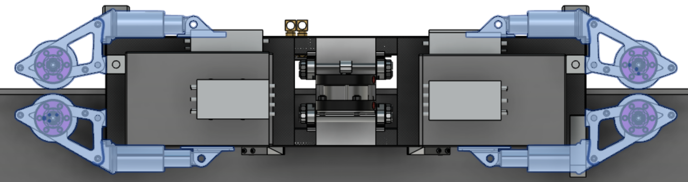
Suspension
Notes:
Optimize friction
reason we haven’t begun testing is due to manufacturer delays
To maintain pod position relative to track while minimizing shocks to the chassis
Lightweight shocks
Damping is important
Simple, unpowered lateral control, low friction, blue tempered steel leaf springs custom design 3d printed mounting components
Powered wheel clamping force optimized for max traction (min slip) with min rolling resistance
Clamping force: 550N
Mass powered suspension: 5.4 kg
Mass lateral suspension: 0.8 kg
Slotted holes and adjustable air pressure allow for optimum spring coefficients

Slide 8
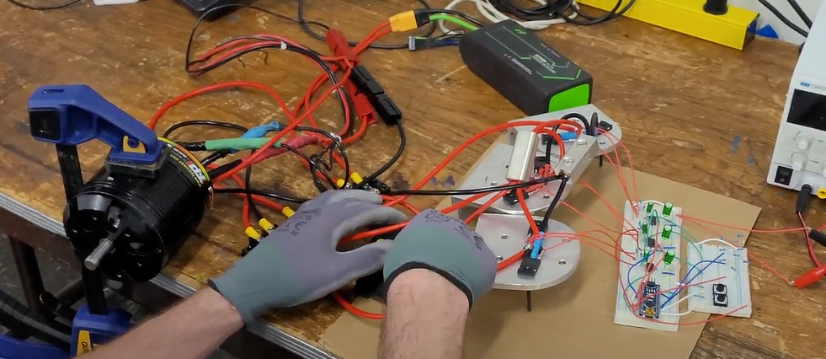
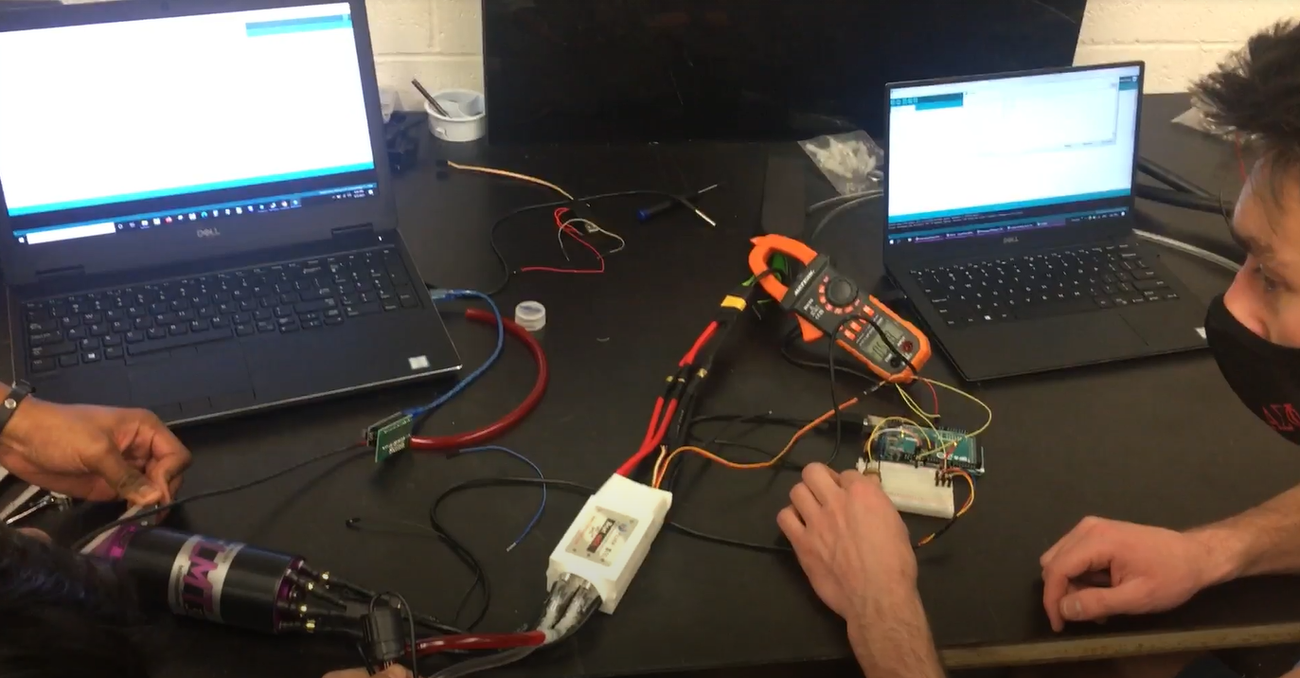
Power Electronics
Notes:
Kael

Slide 9
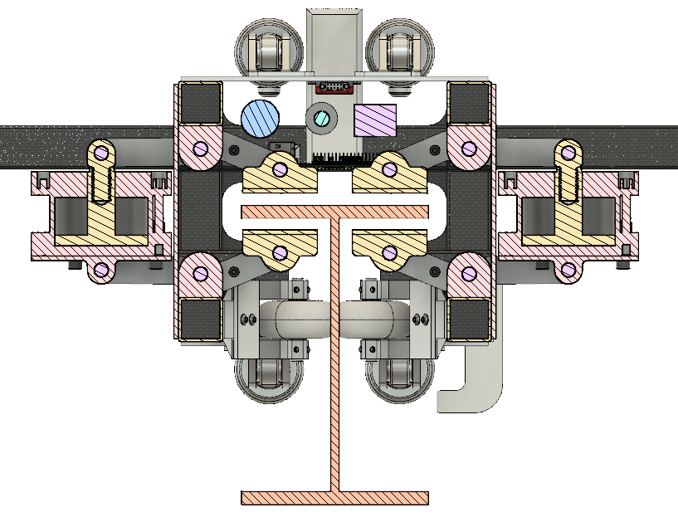
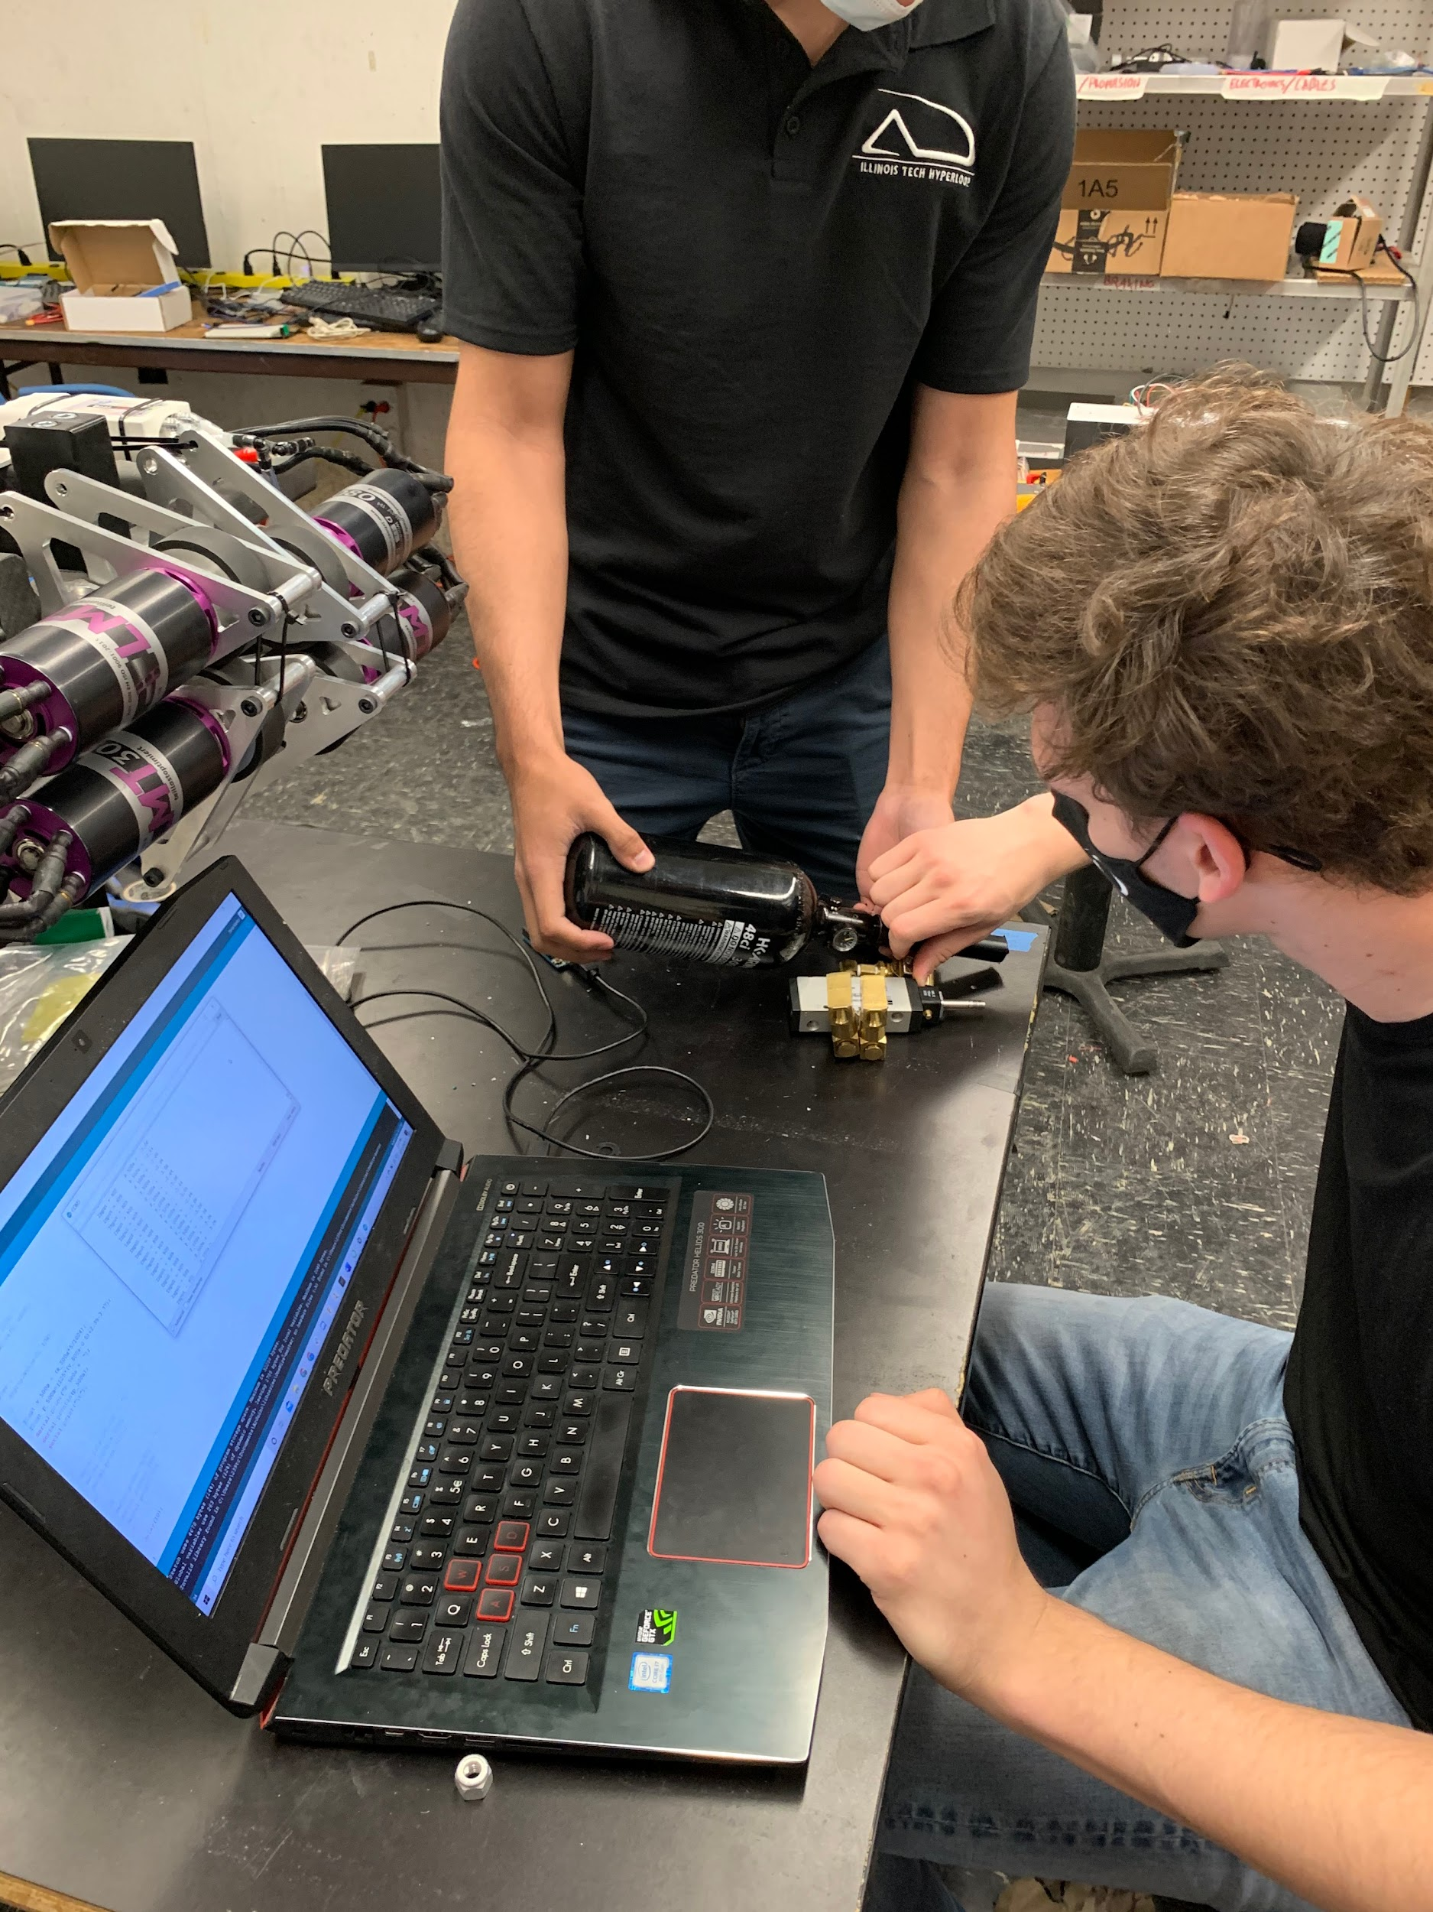
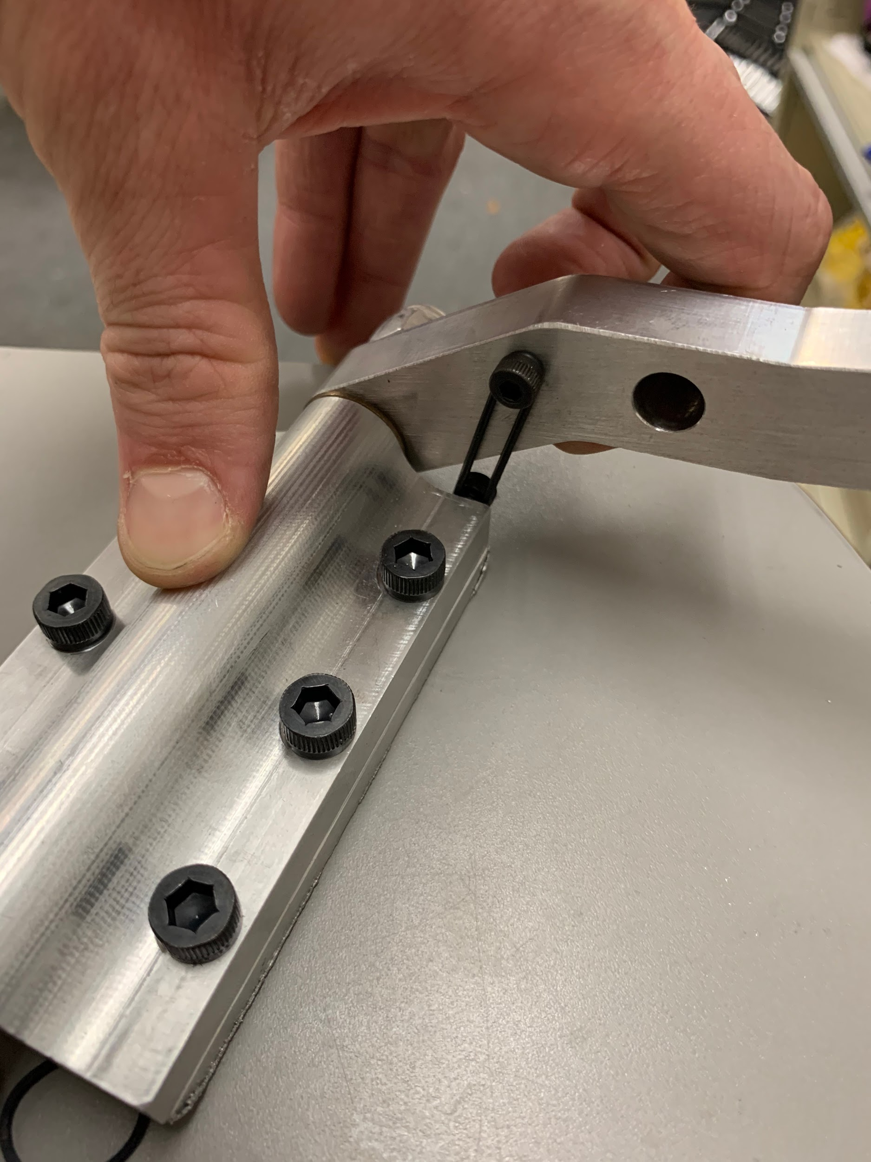
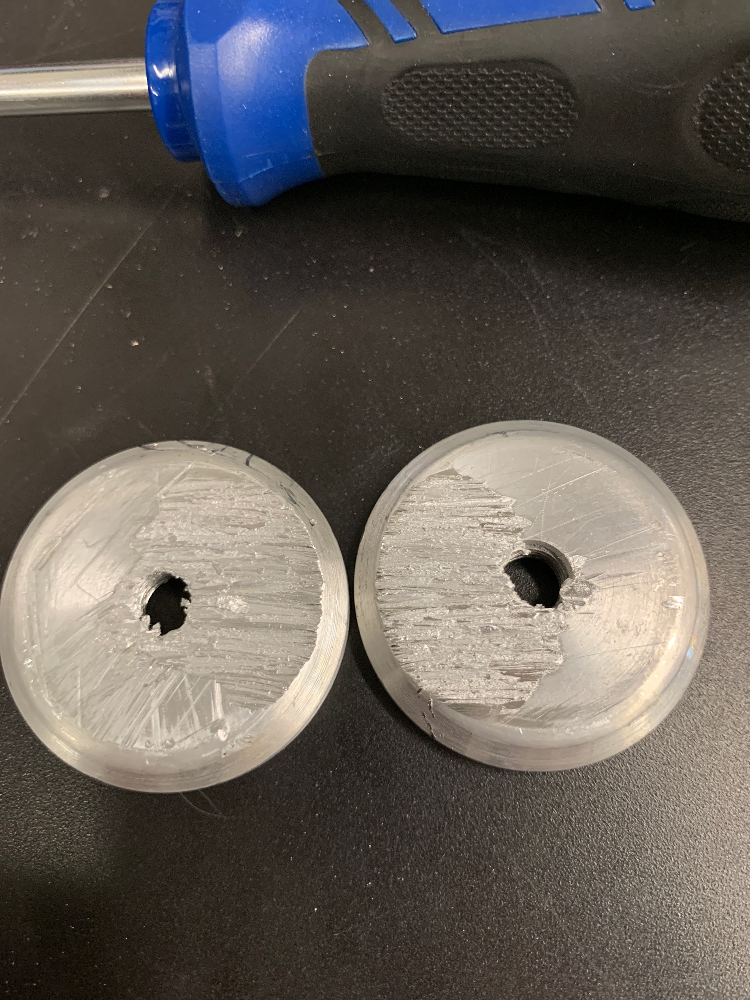
Braking
Notes:
Kael

Slide 10
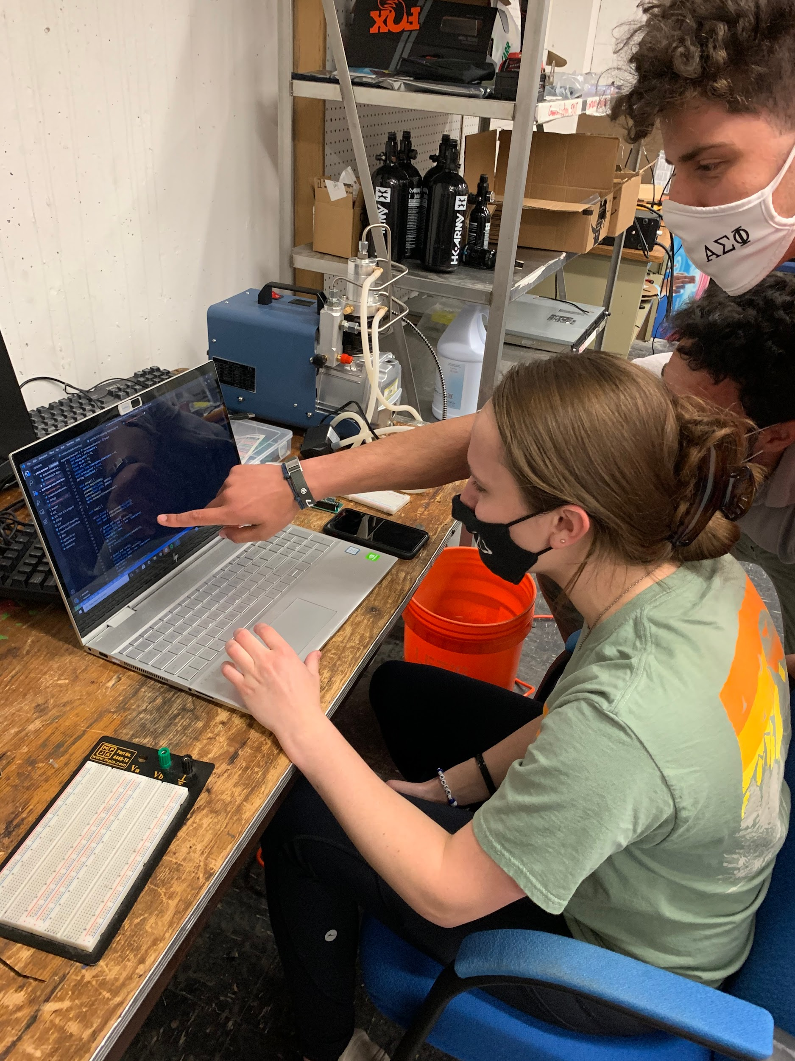
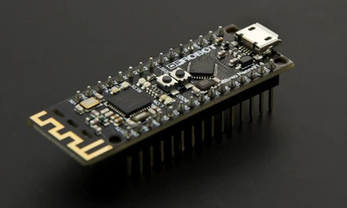
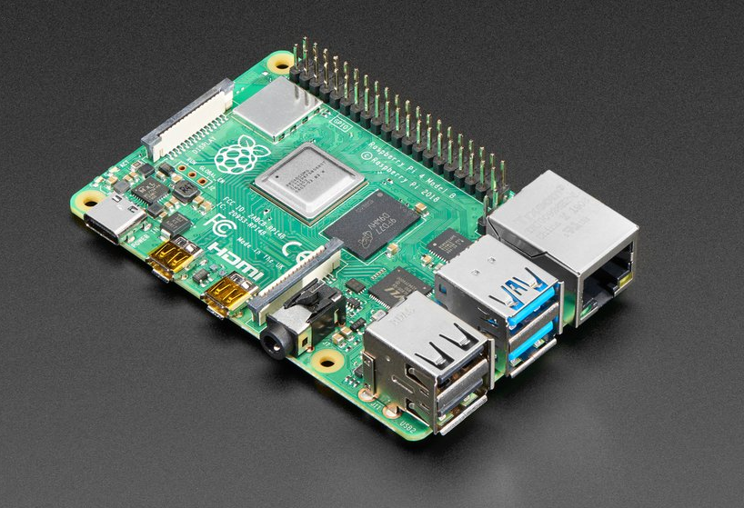
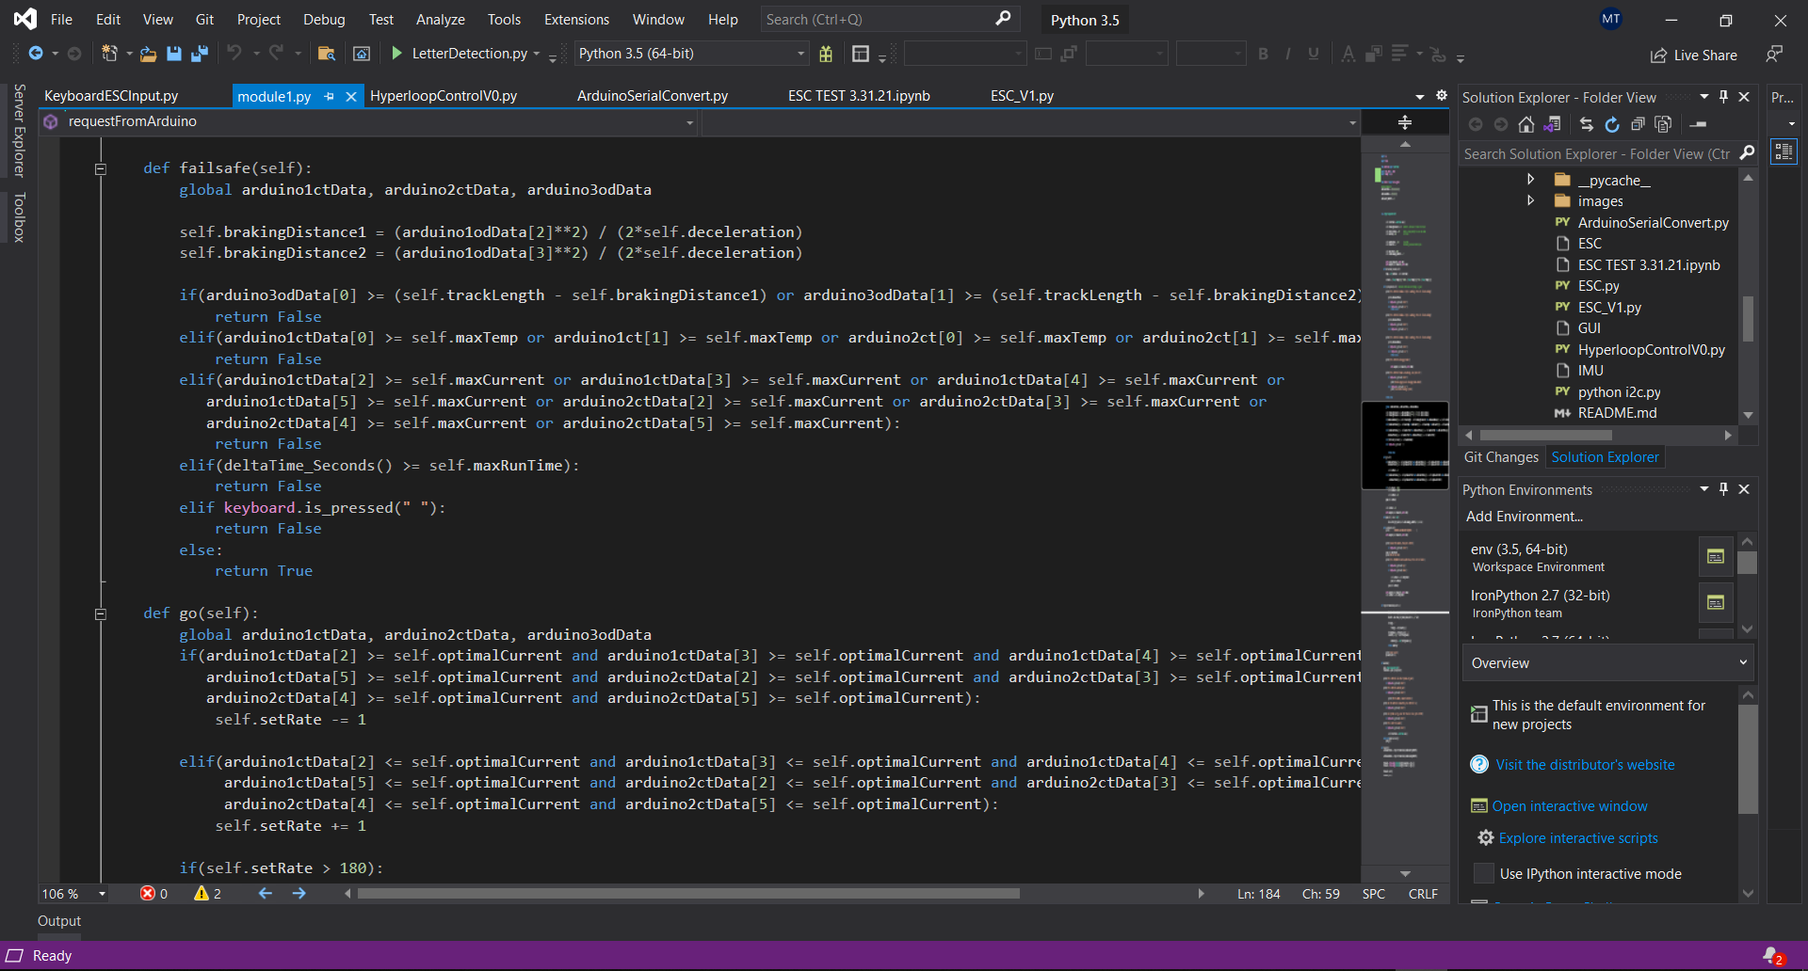
Software and Controls
Notes:
Kael

Slide 11
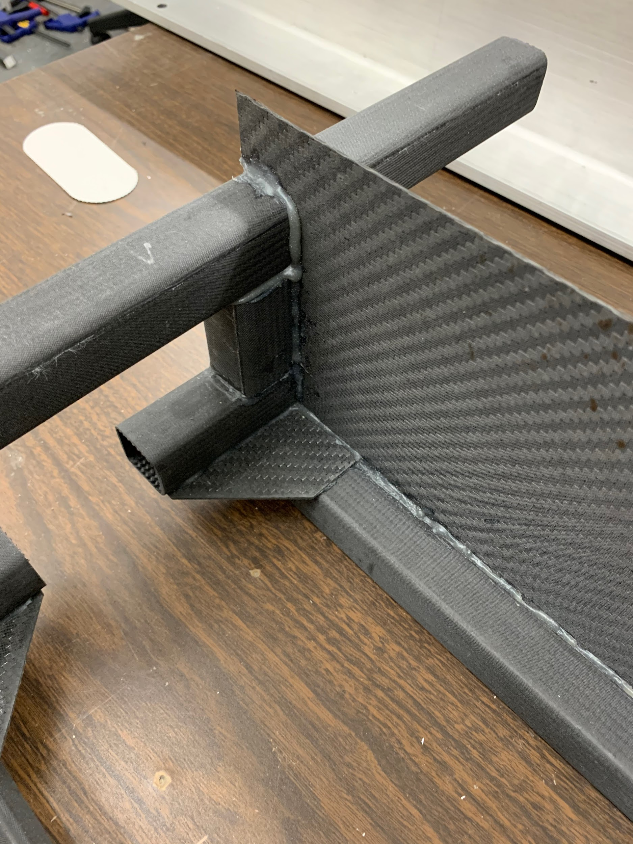
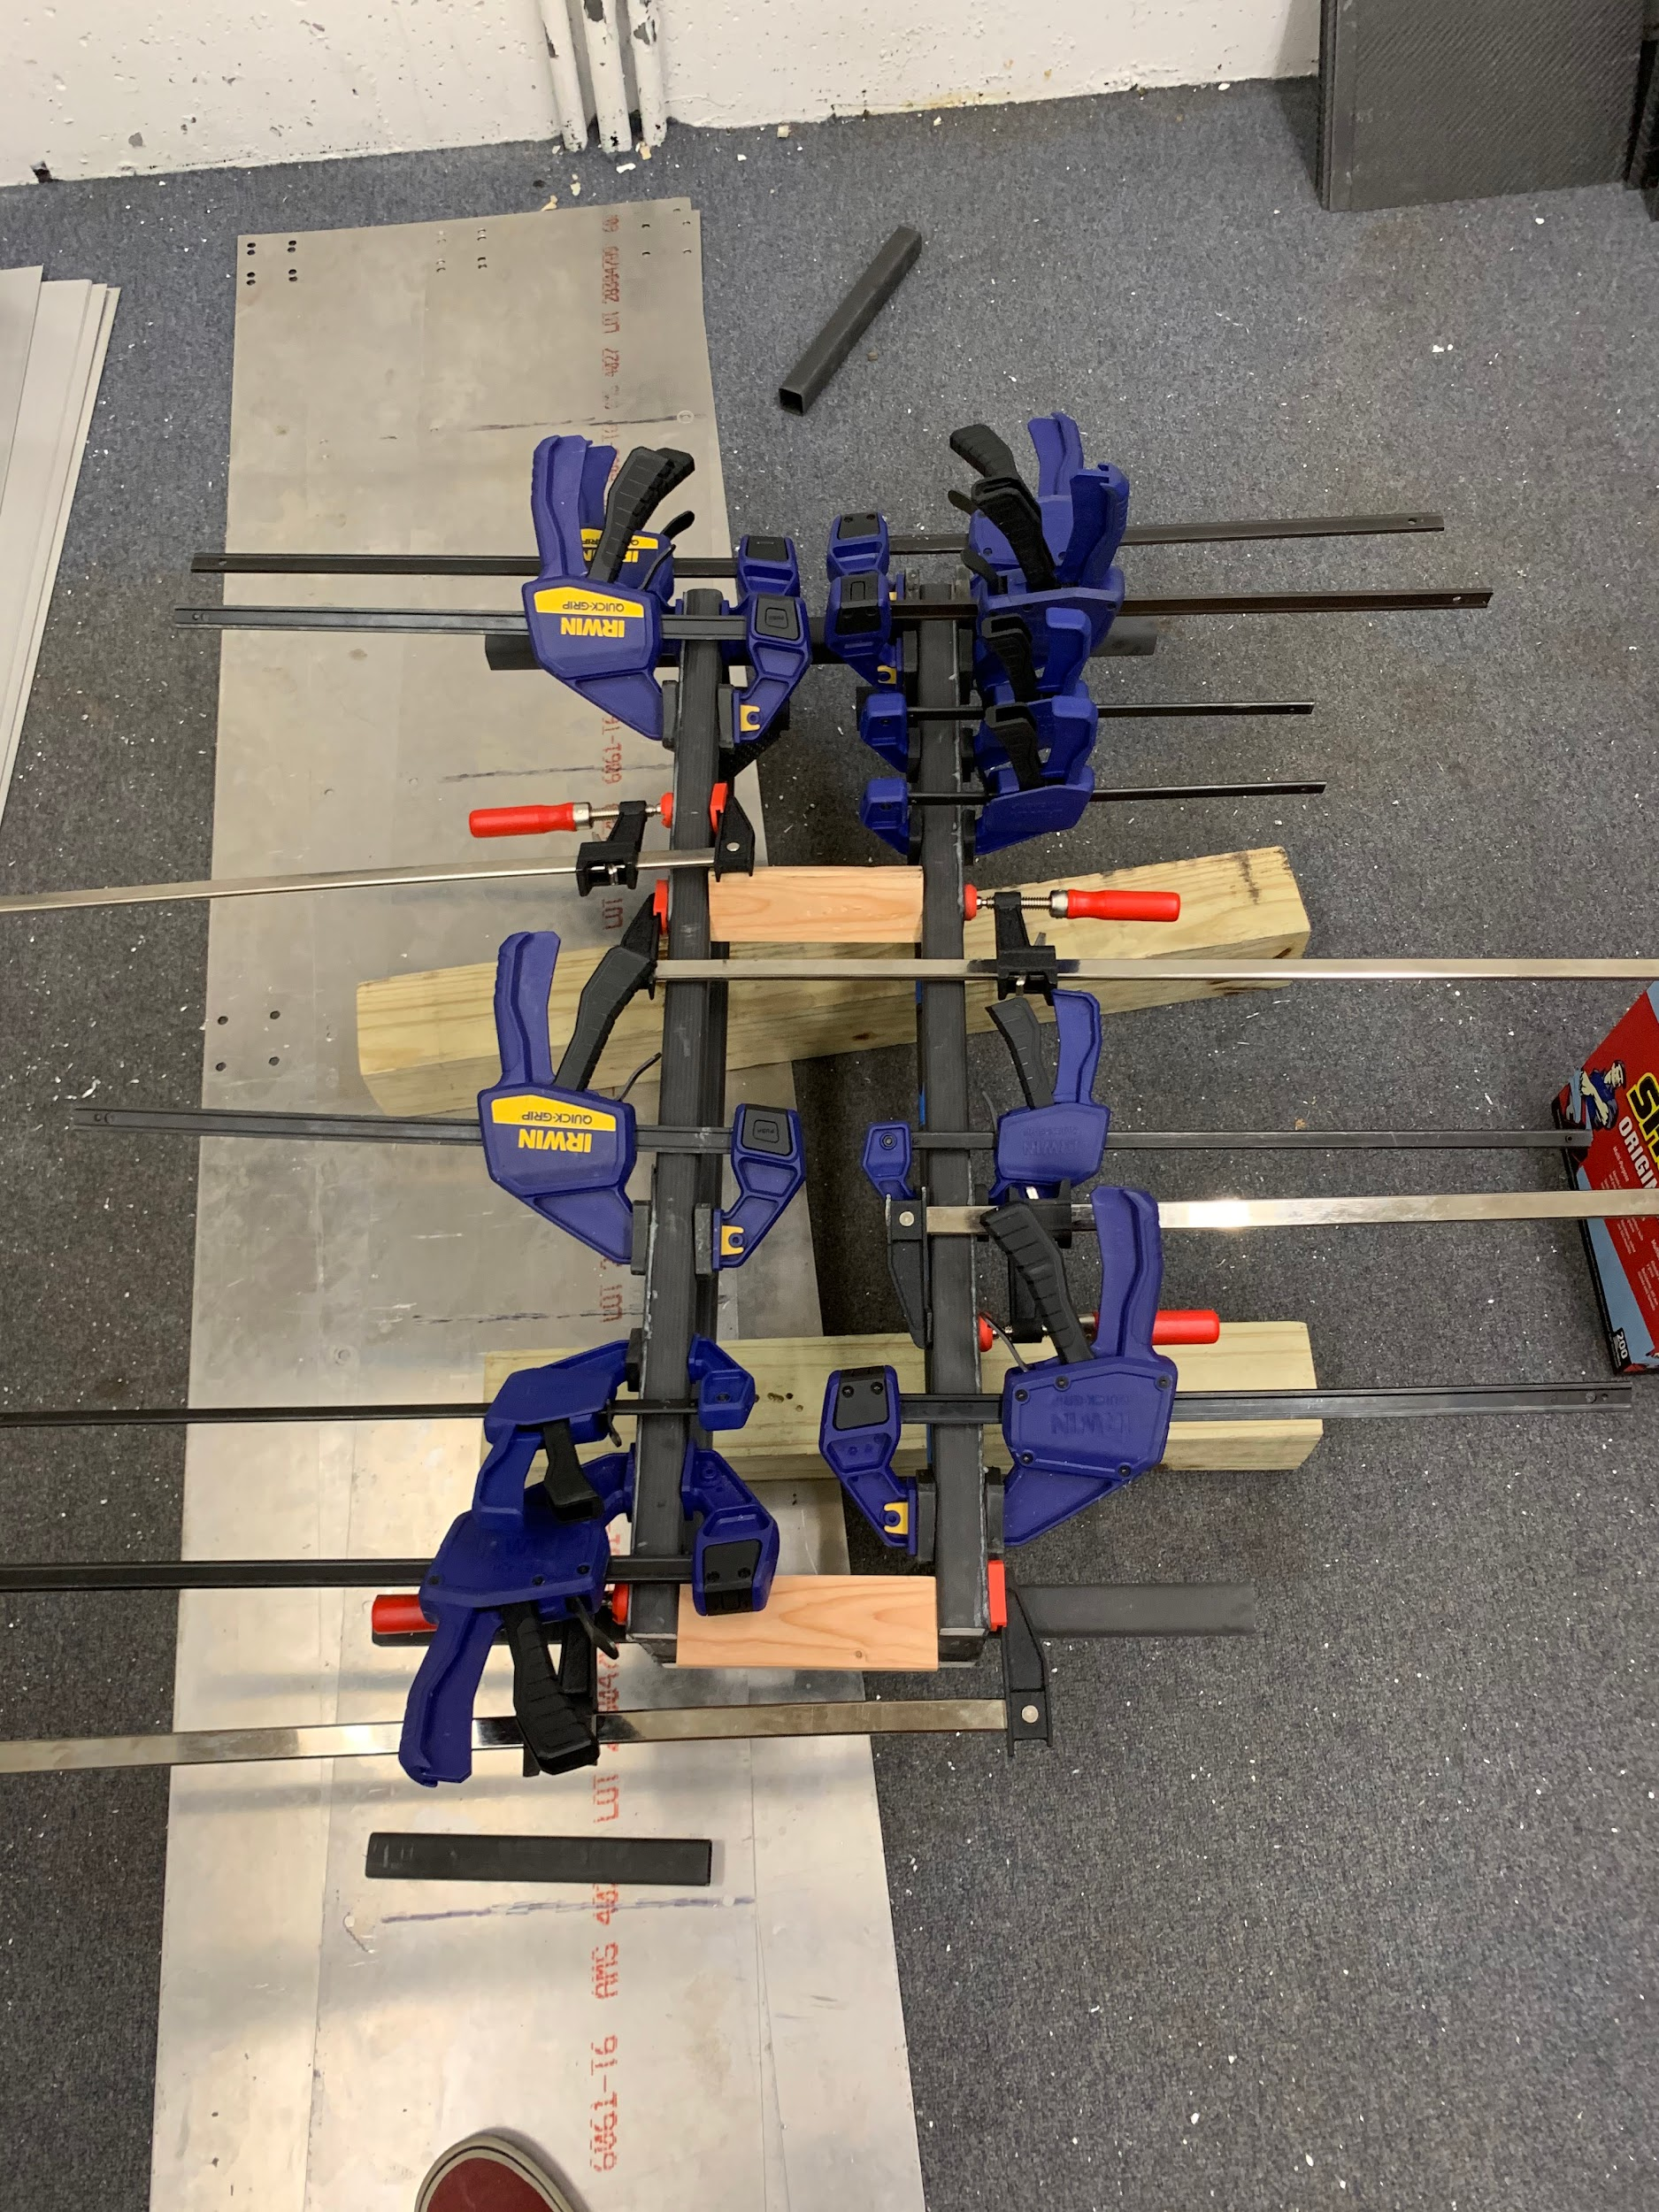
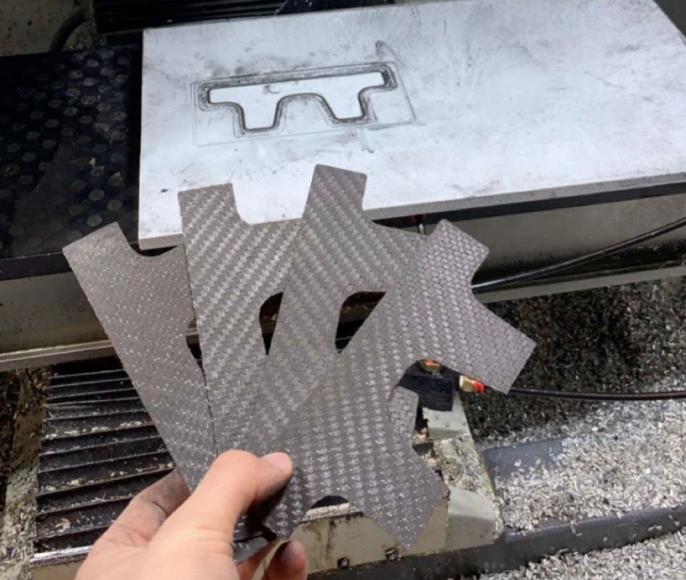
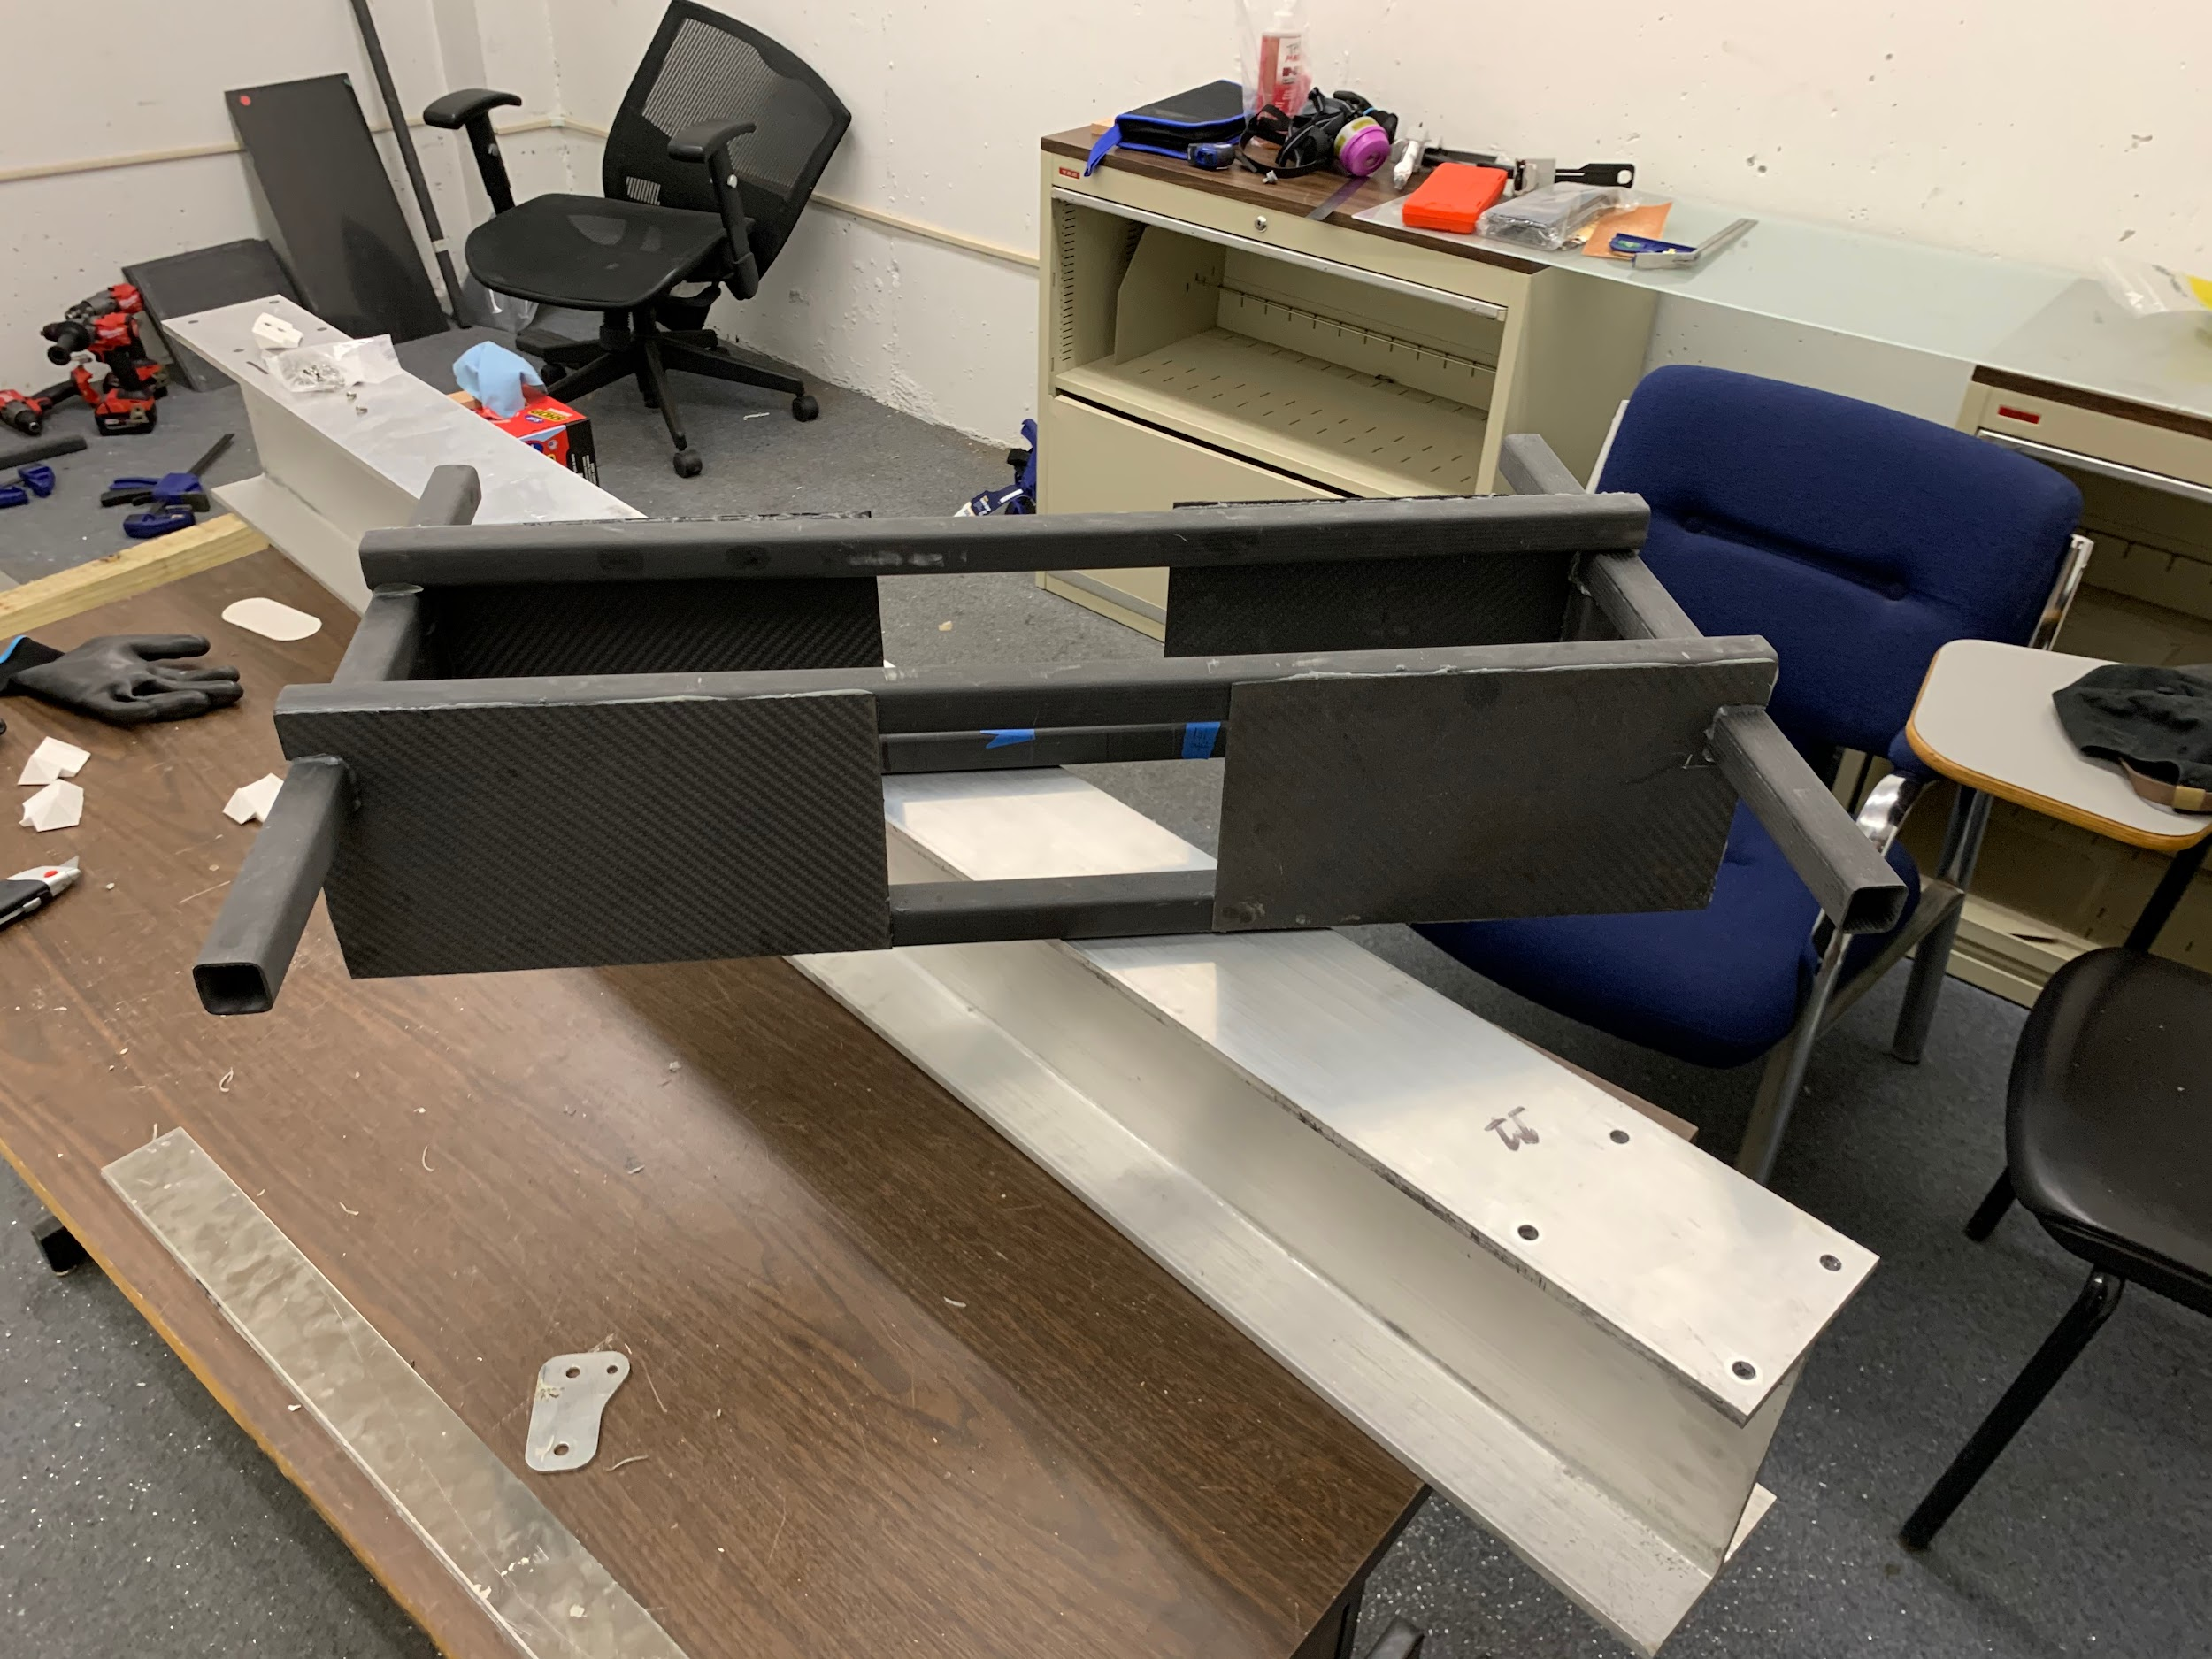
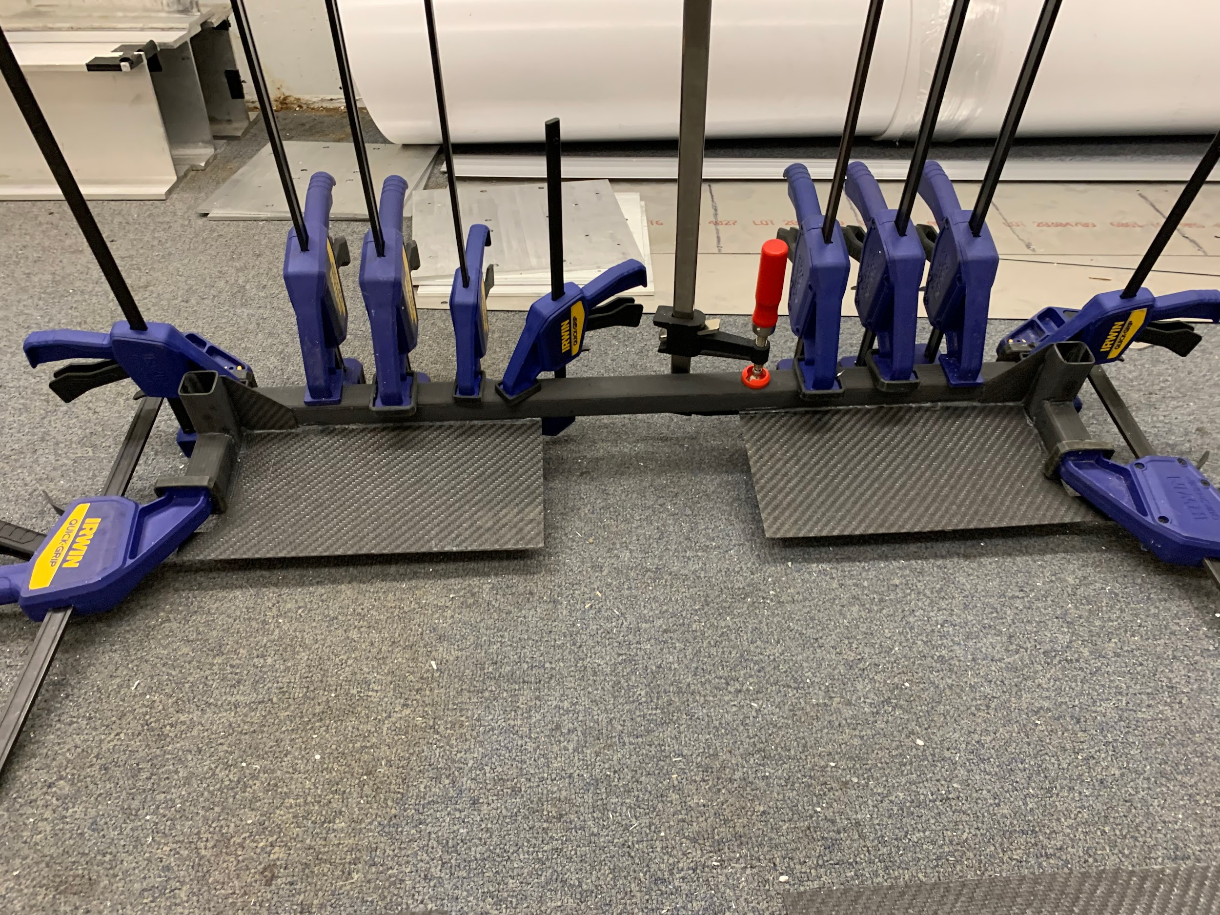
Structures

Slide 12
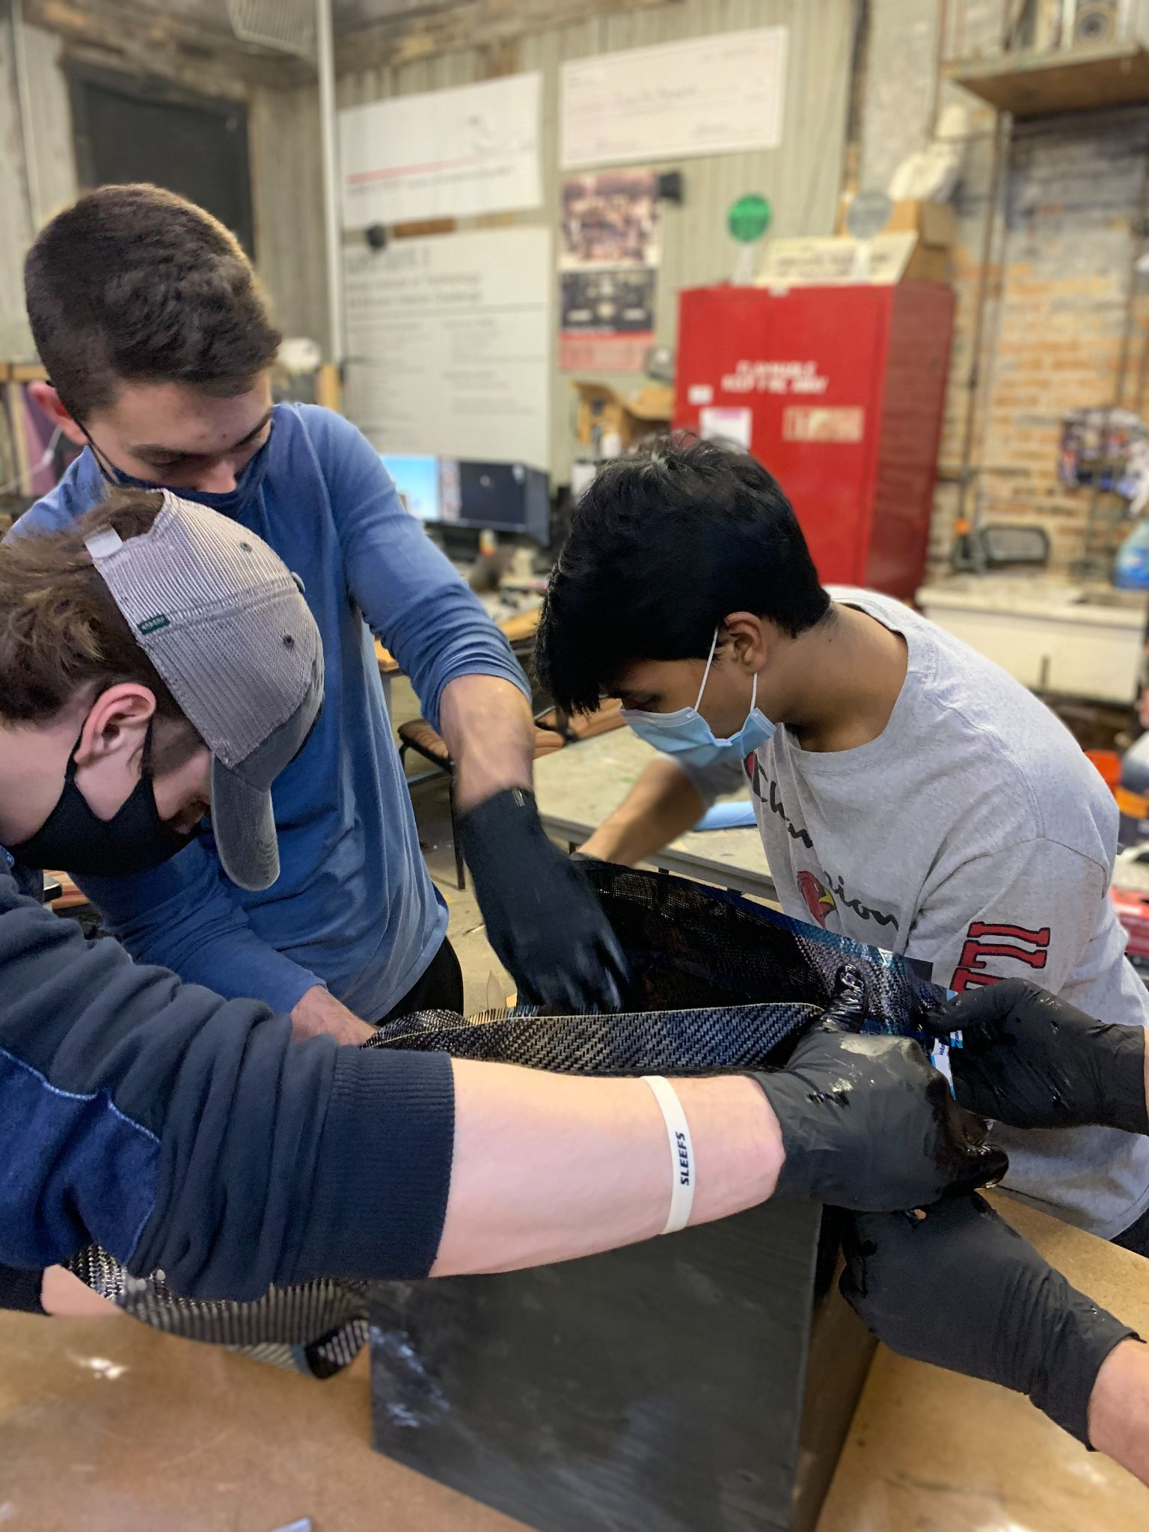
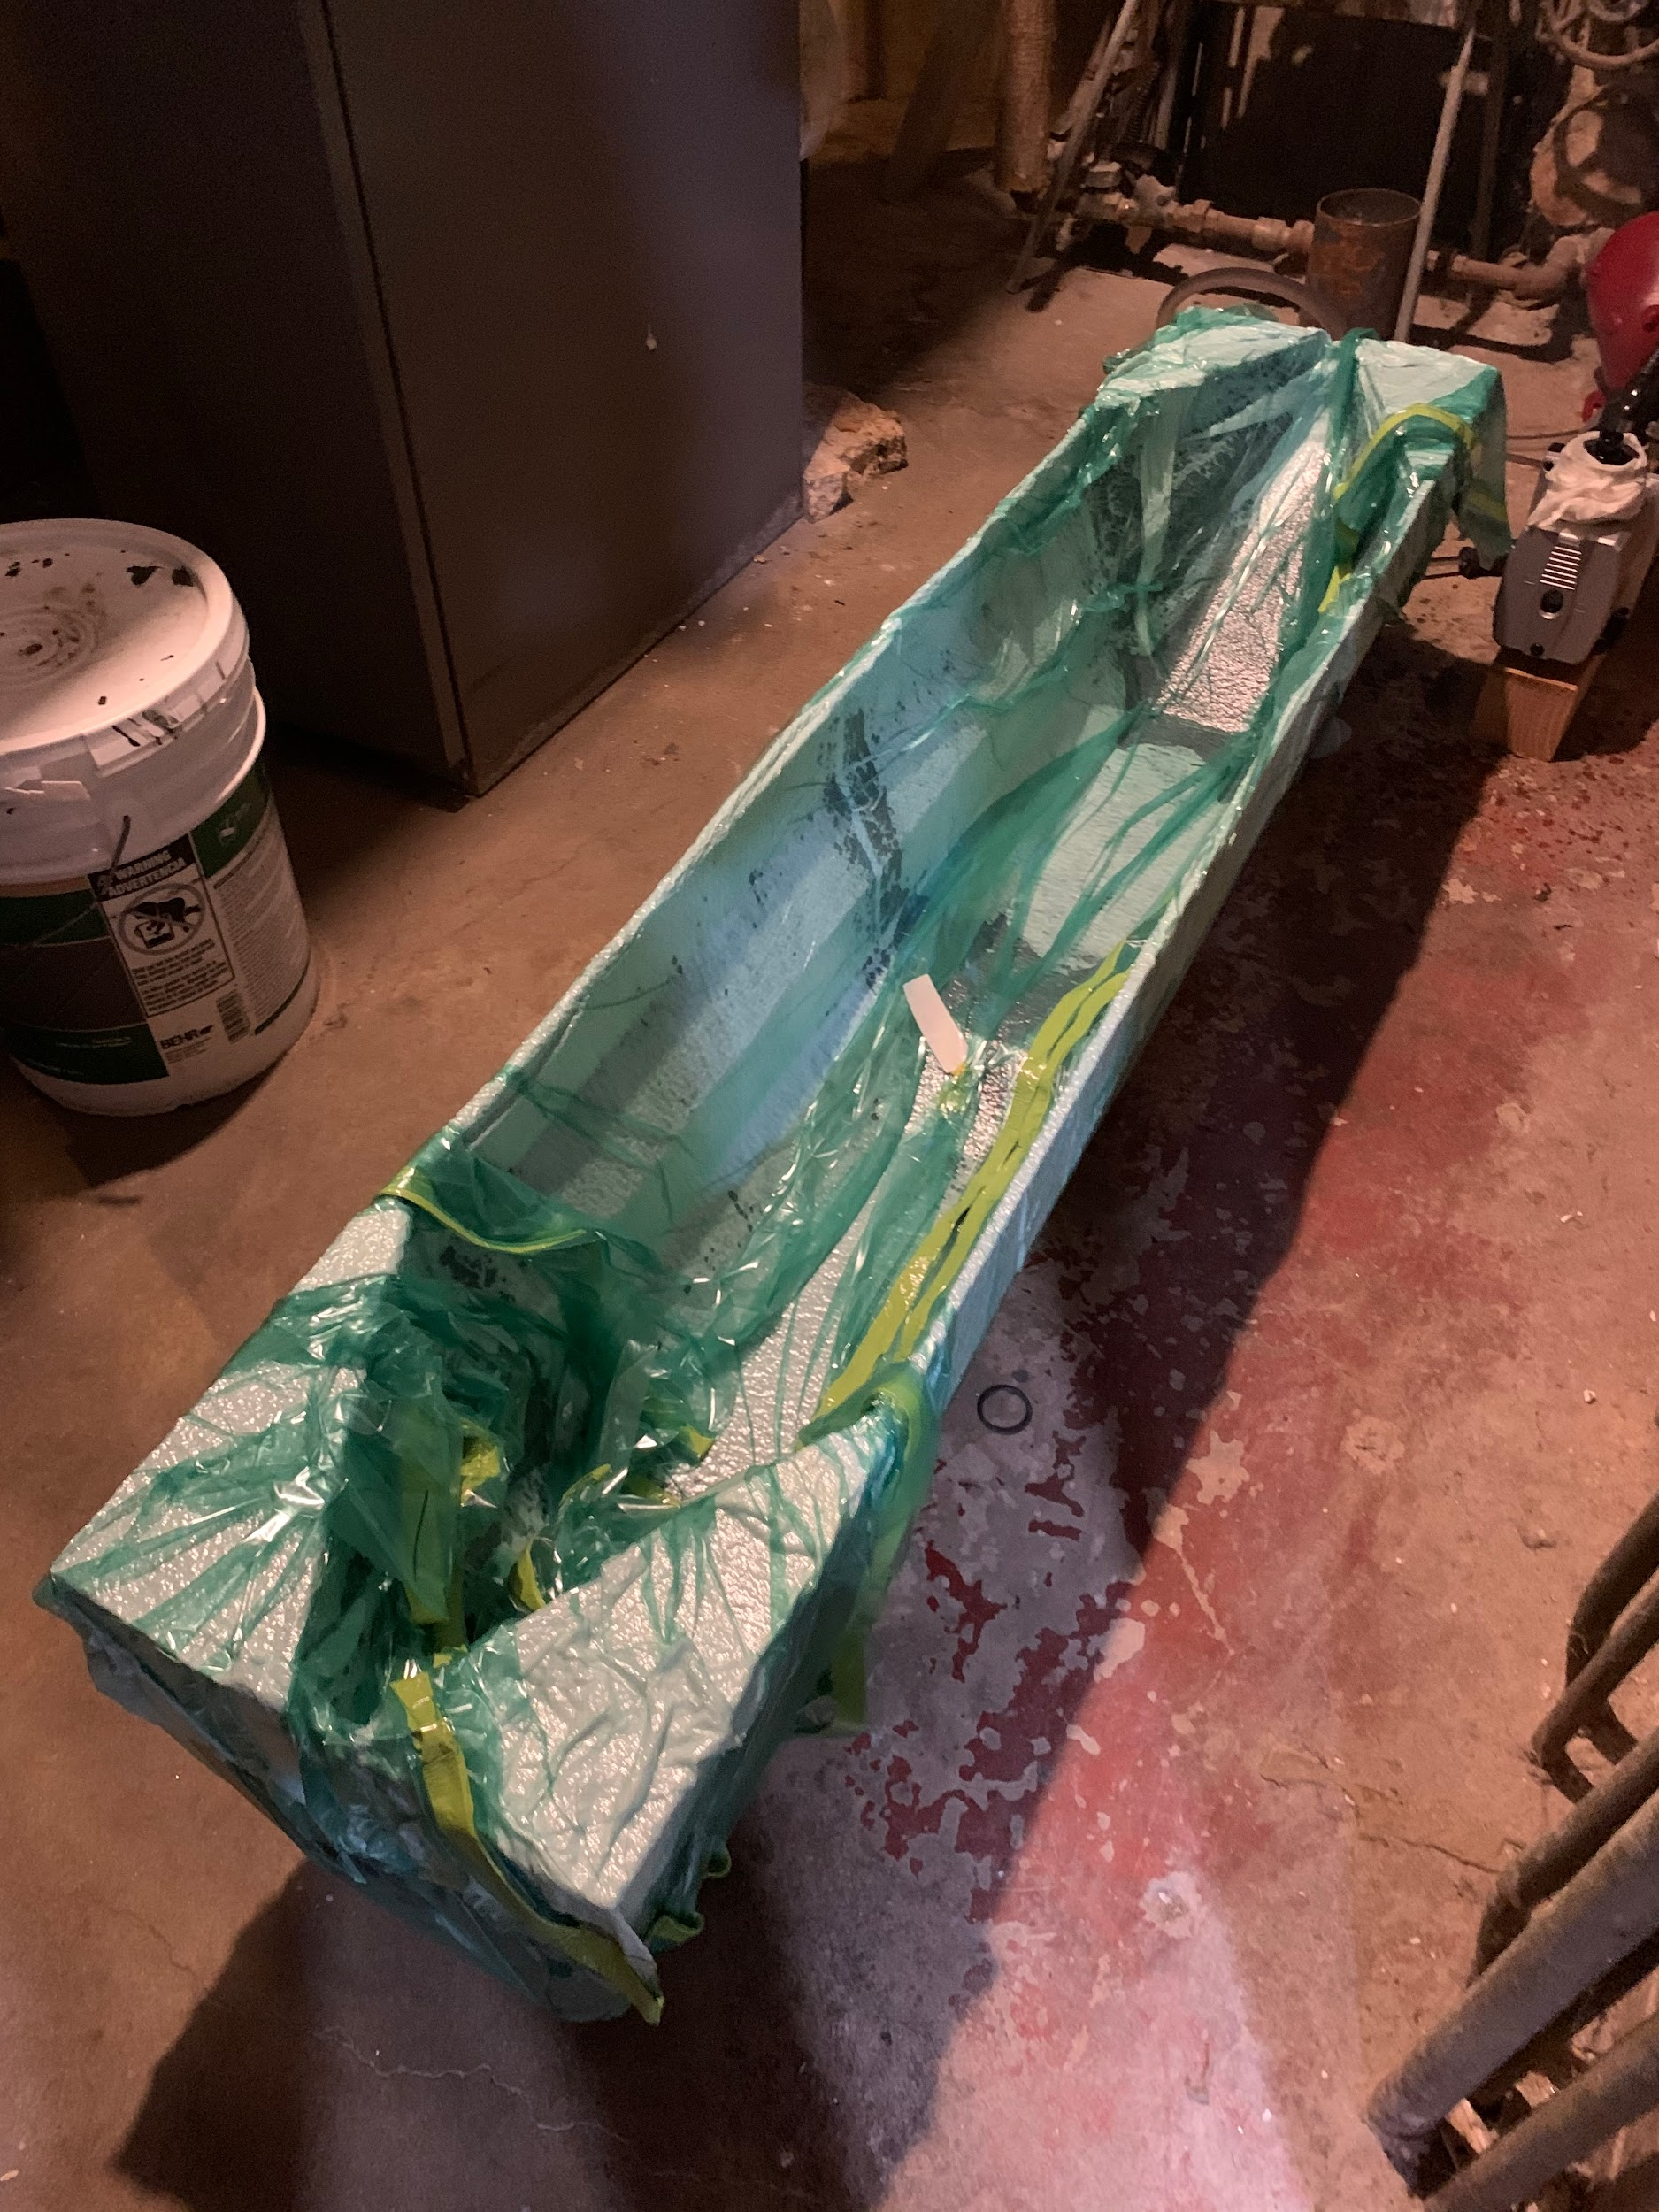
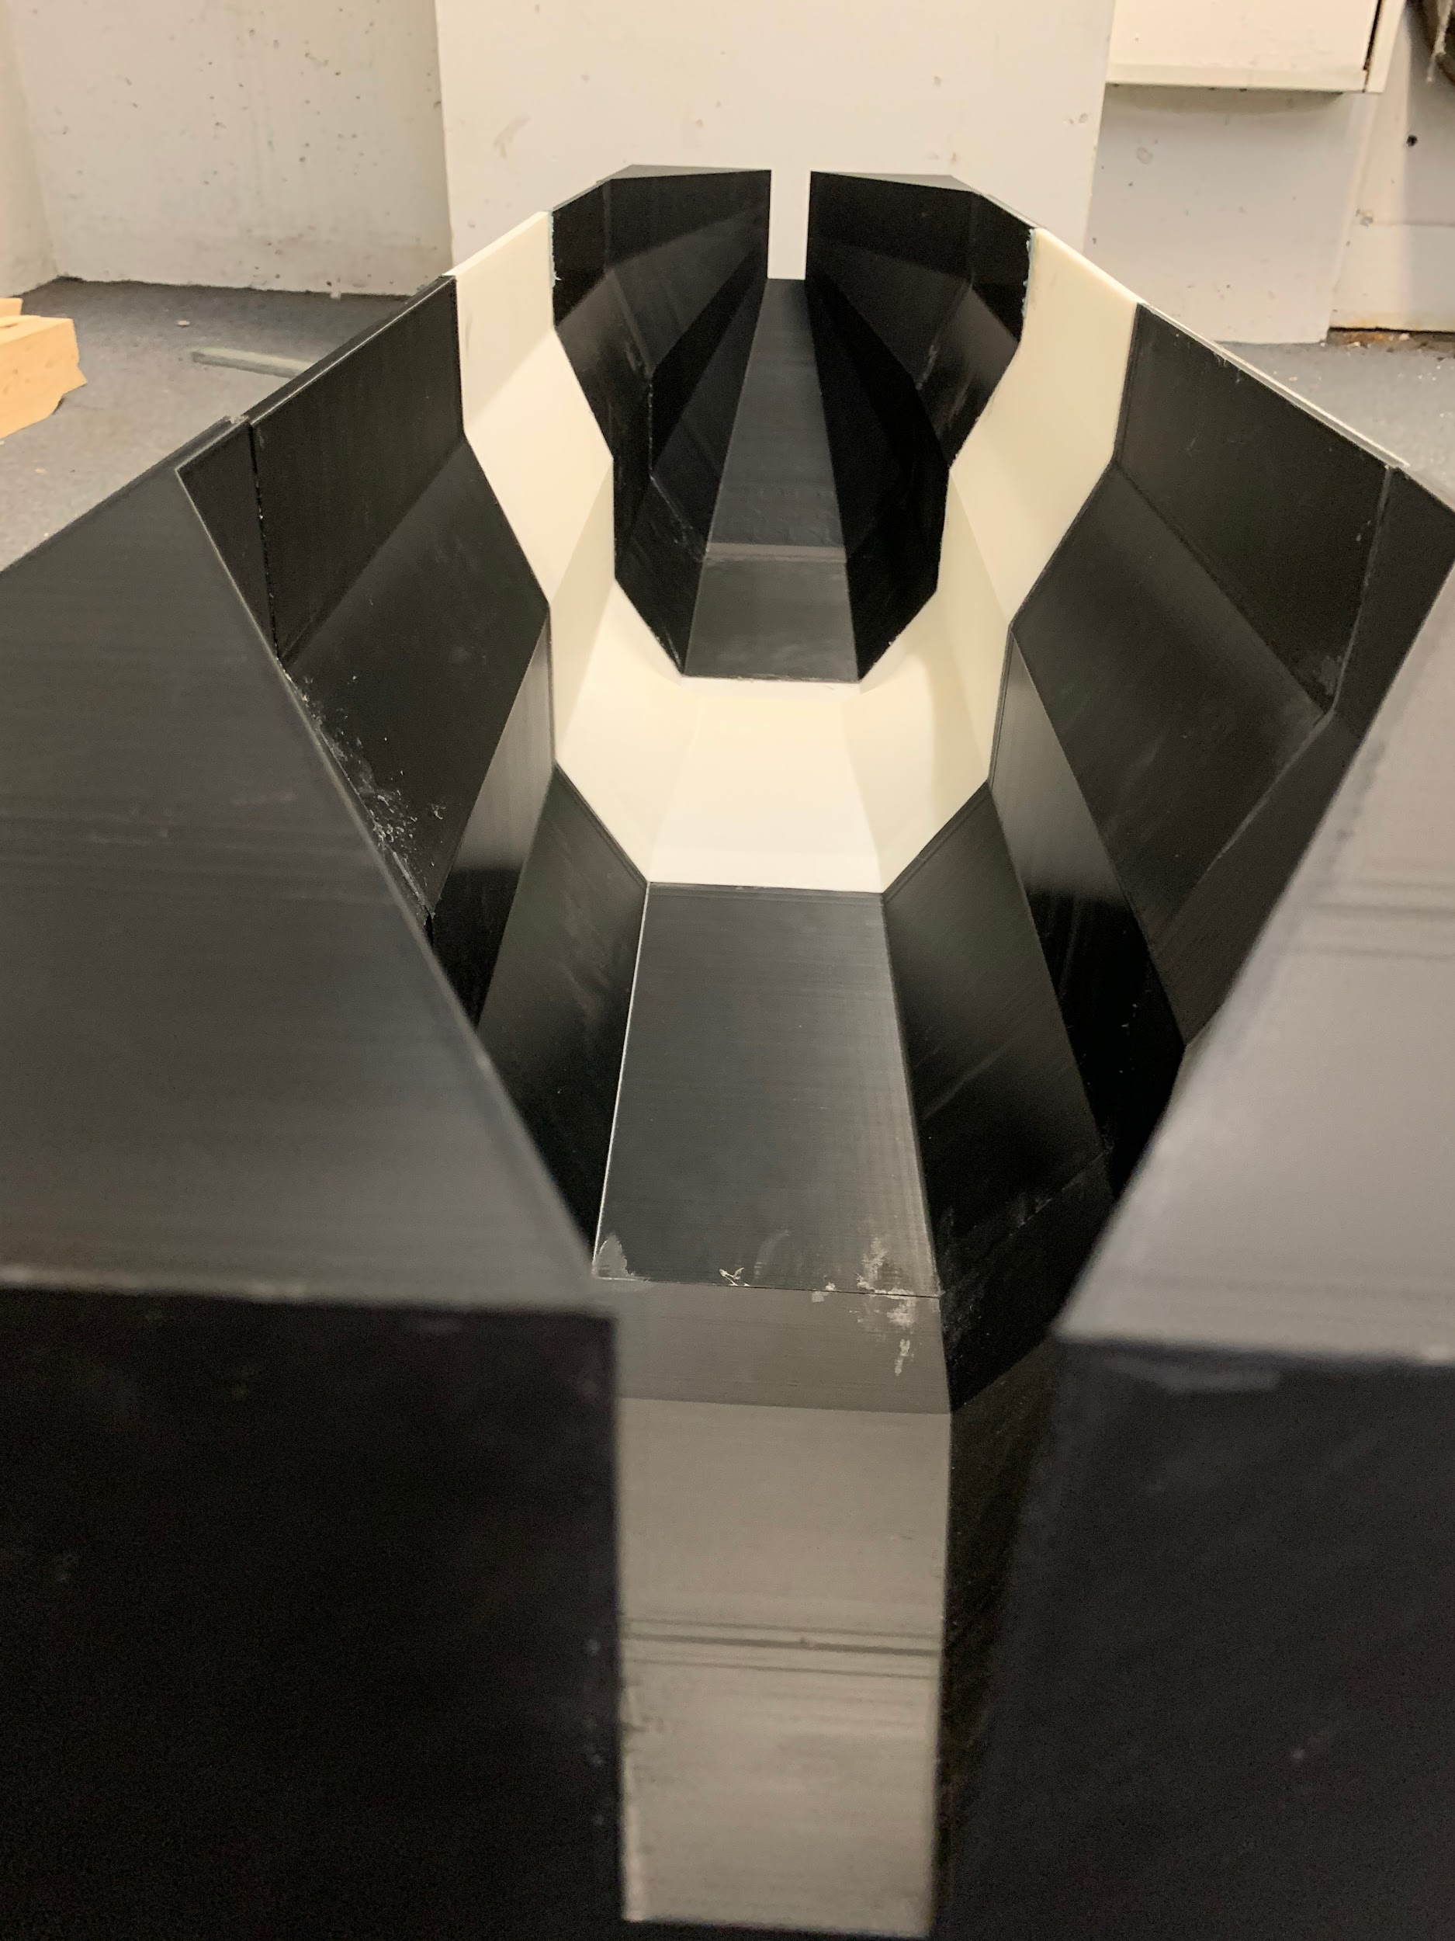
Aerodynamics
Notes:
Kael

Slide 13
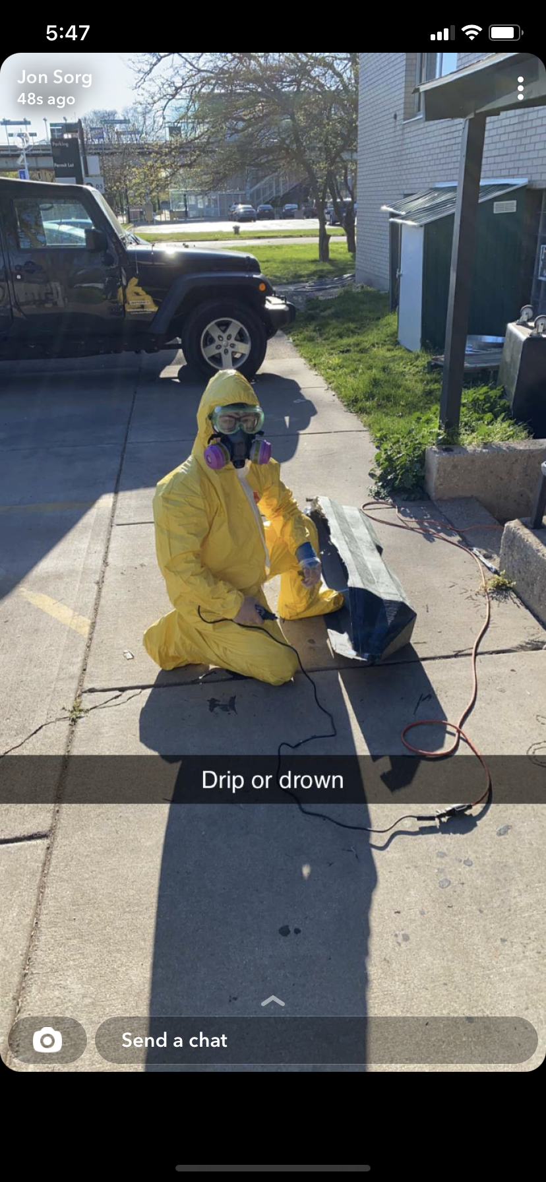
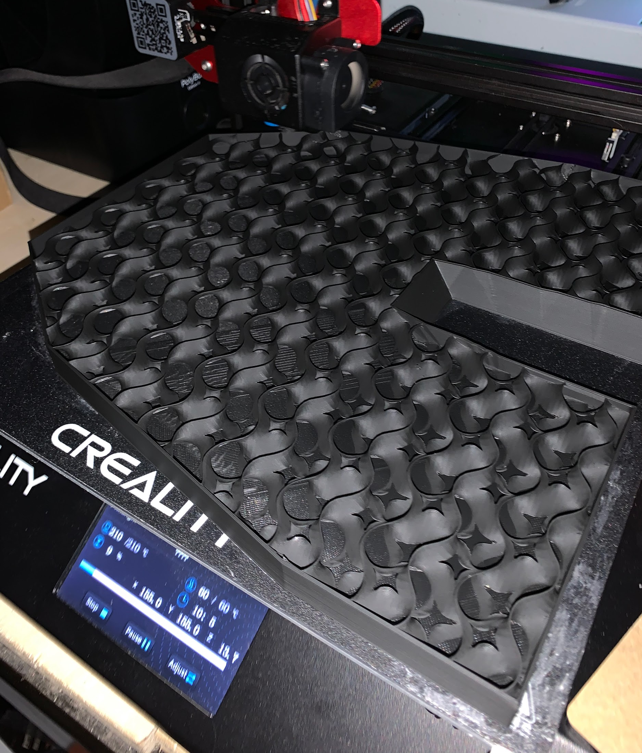

Slide 14
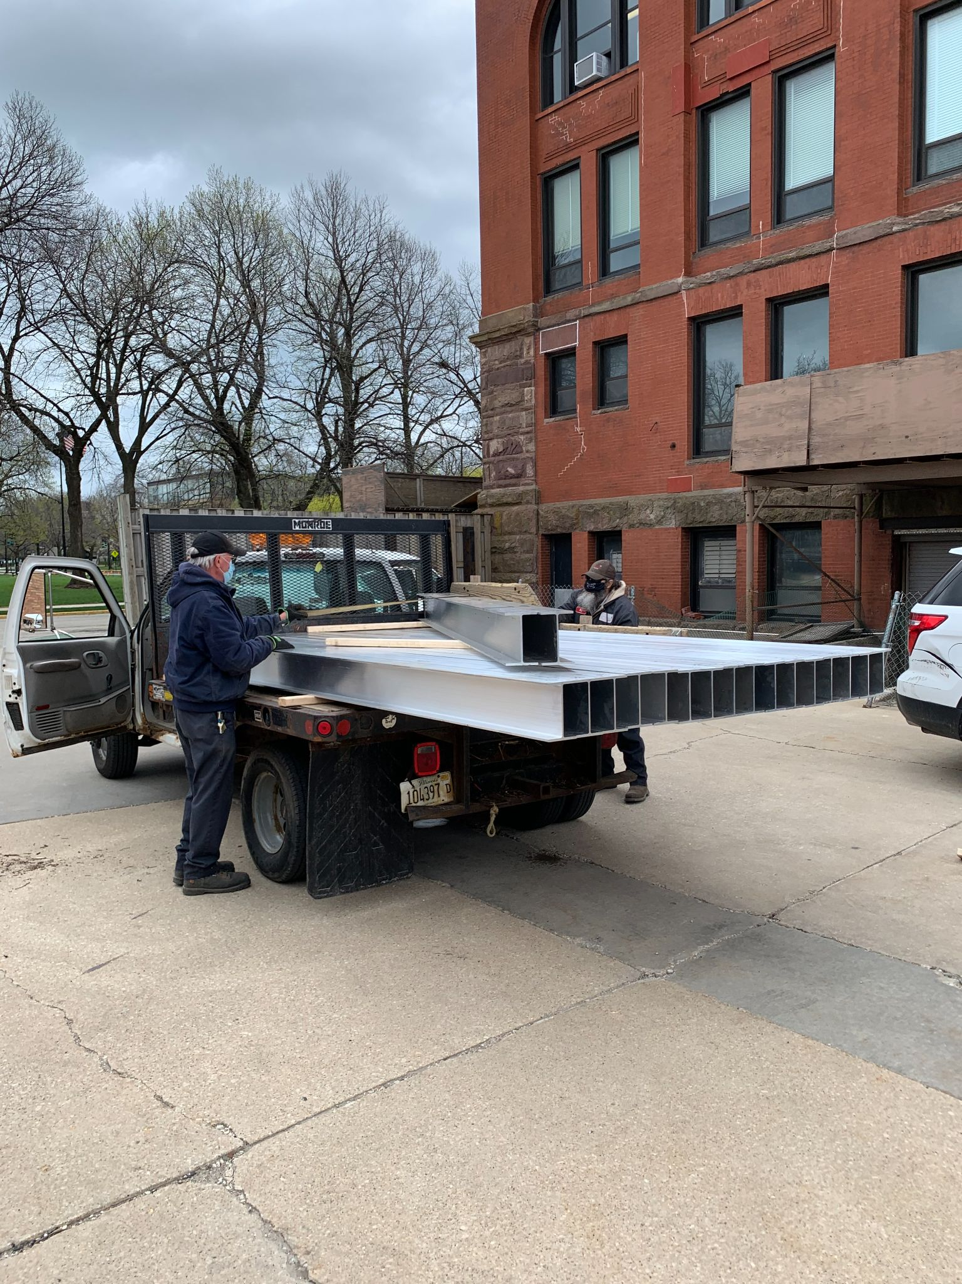
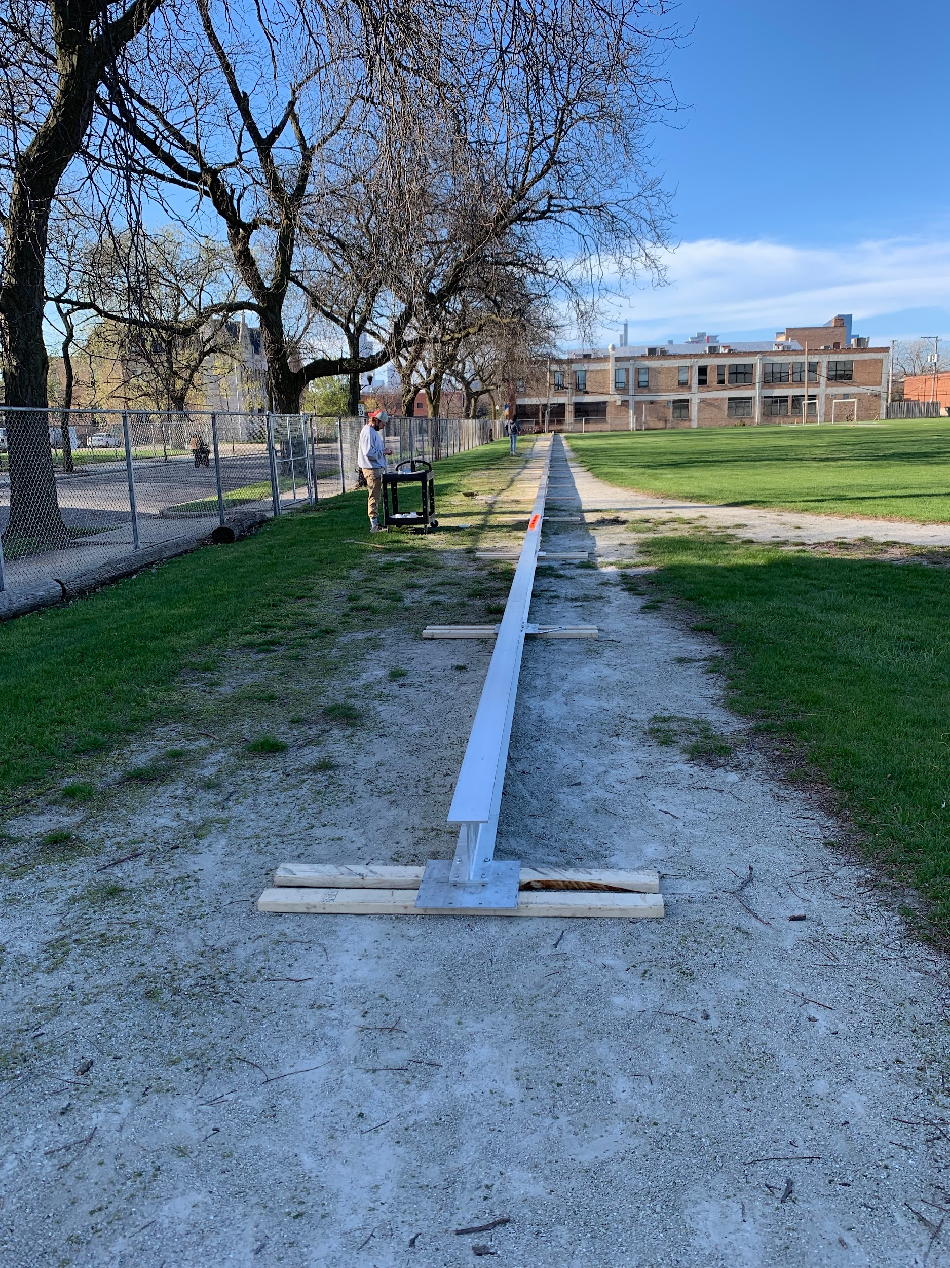
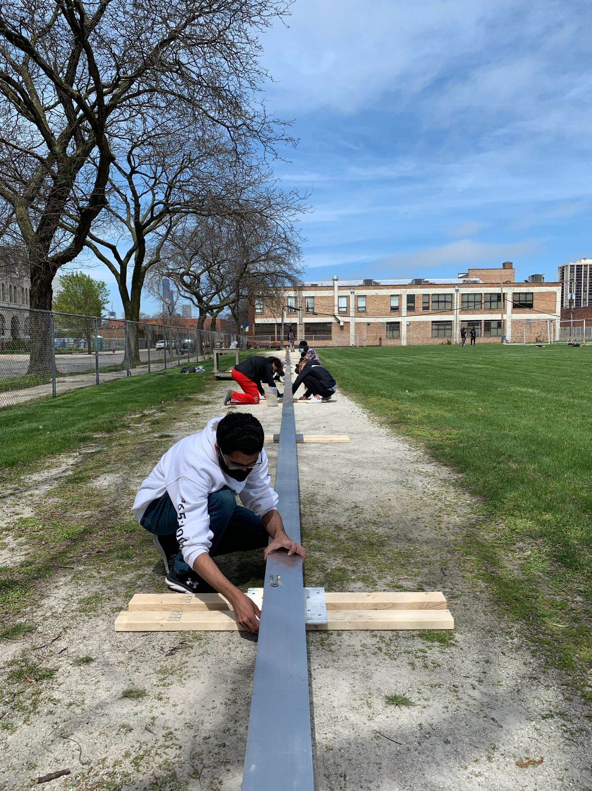
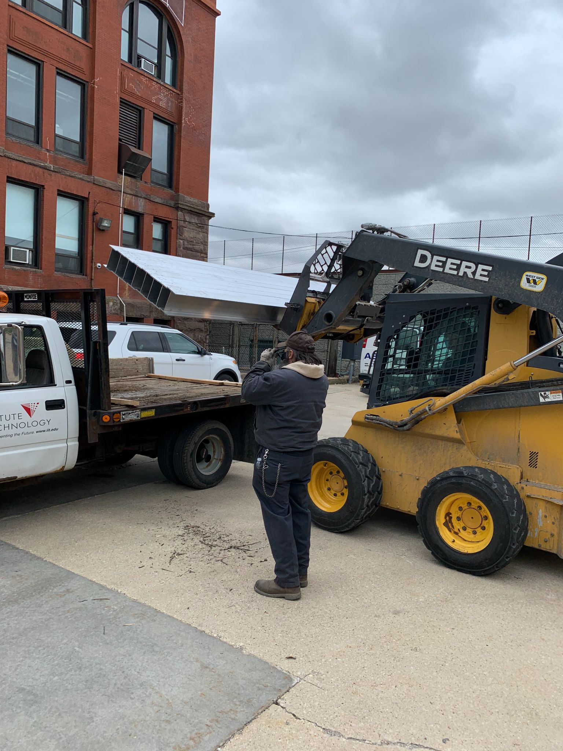
Test Track
Notes:
Vince
Since our end goal with this organization is to compete at the space x competition we needed to find a way to not only test but debut our pod.
We decided to design a test track that would allow us to test the acceleration of pod
The specifications of our test track is 400 ft long and 4 feet wide
The cost to fabricate the track is 7500 dollars
And the mass of the track is just over 1000kg
Since testing on our own track can be considered dangerous we have taken safety precautions such as an emergency hard stop incase of braking falure and barricade tape around the track.

Slide 15
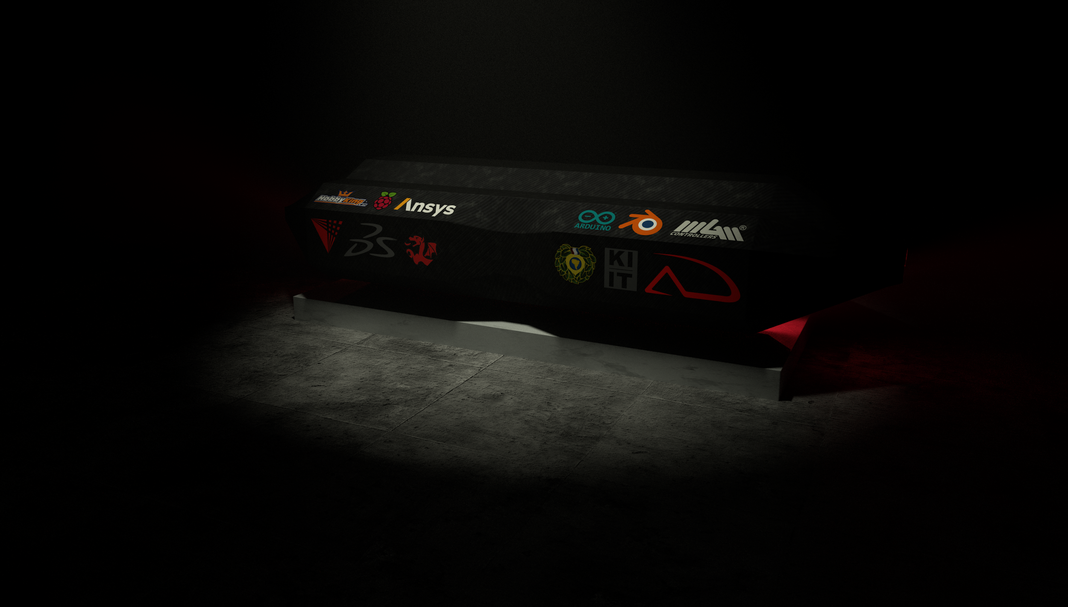
Thank You!

Slide 16



